Slide 1
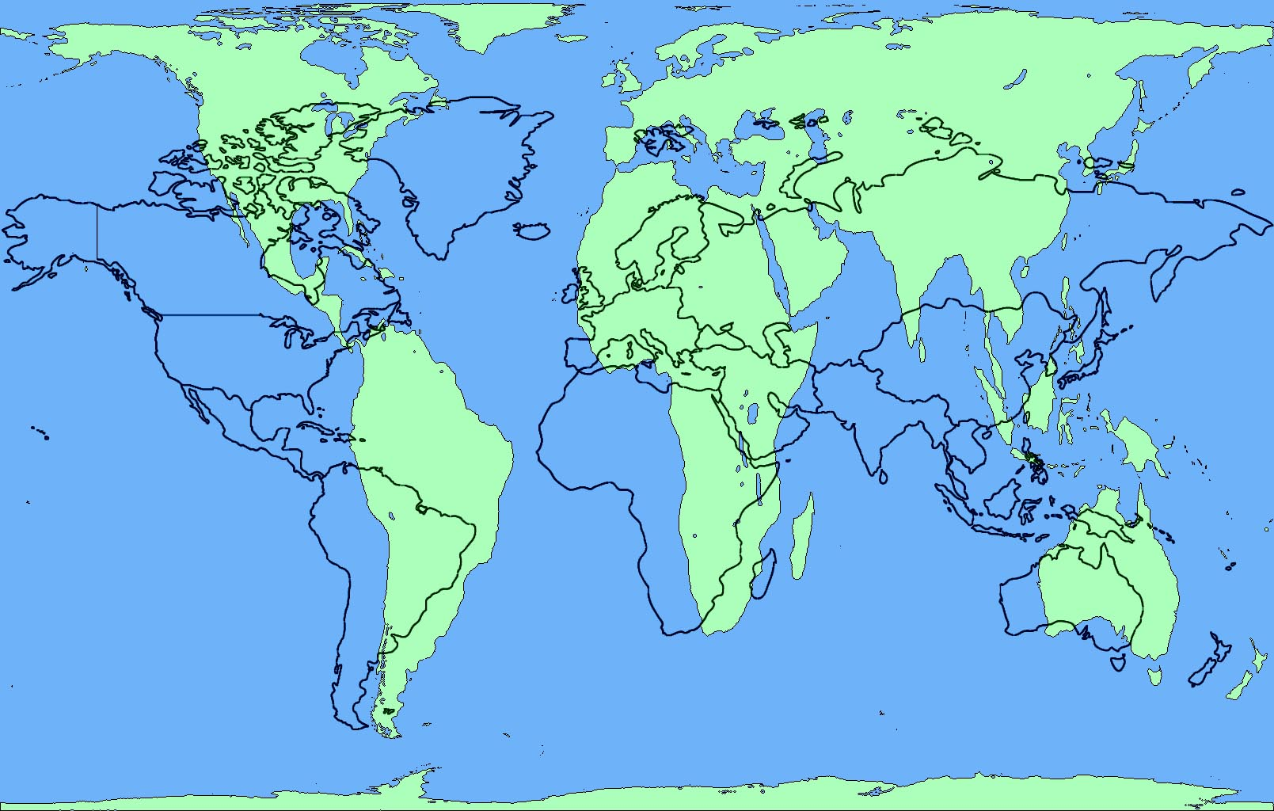
September 7, 2016 Do Now 1. Title your notebook : Unit 1: The 5 Themes of Geography 2. Take out your Principles/Elements of Design paper 3. Answer the following question: What qualities make a design good? DO NOW

Slide 2
Today’s Agenda
Who You Are Project
Academic Success
I examine the 5 Themes poster and identify and explain explain verbally the positive and negative aspects using academic language from the principles and elements of design.
I define and explain in writing the aspects of each of the 5 Themes of Geography using academic vocabulary.
Introduction: We know who we are, not let’s learn where we are…

Slide 3
Do Now Discussion
What makes a good design layout?
How do you know?
Elements and Principles of Design:
Line
Shape
Texture
Space/Depth
Color
Value
Balance
Unity
Emphasis
Contrast
Pattern
Rhythm
Movement

Slide 4
Unit 1: 5 Themes of Geography
Big Idea: Theme and Organization
Essential Questions:
How/why do Geographers organize the world thematically?
How can understanding each theme of Geography help me better understand the world, other people, and myself?

Slide 5
Unit 1: 5 Themes of Geography
Purposes: Or, why we are doing this
To understand how the the world is organized geographically
To understand how people relate to each other and their environments
To understand how I relate to the other people and the world

Slide 6
5 Themes of Geography Poster Critique
Final Assessments:
Redesigned 5 Themes Poster
5 written paragraphs about each theme based on research
Written evaluation and reflection

Slide 7
5 Themes of Geography Poster Critique
What principles and elements of design are used well? Why?
What principles and elements of design could be improved? Why? How?
Write 3 things that are done well and why they are done well
Write 1 improvement that can be made in your notebook, and why

Slide 8
5 Themes of Geography Poster Critique
How would you rate the craftsmanship?
How could it have more “duende”?
Write 1 thing done well with regard to craftsmanship or duende, and state why it is done well.
Write 2 improvements that can be made with regard to craftsmanship or duende in your notebook, and why.

Slide 9
5 Themes of Geography Poster Critique
How did the makers improve on the poster?
Compare and Contrast
What did they change with regard to principles/elements of design, duende, and craftsmanship?
Write 3 improvements they made, and whether you think they were successful

Slide 10
5 Themes of Geography Poster Project
You will be redesigning the 5 Themes Poster to make it more visually interesting and informative
Last year’s work: How could it be improved?
You will define each theme
Explain each theme based on a location of your choosing
Provide pictures that enhance your definitions and explanation.

Slide 11
Final Project
Redesign the 5 themes poster using images and information based on a place you and your partner select
Your redesign must have all the same headings and elements, but have images and additional definitions, explanations, and information
You can create the poster digitally or physically

Slide 12
Exit Ticket
Select your partner
Write your names on the rubric
Select the place you both will research
Write in project name
On the back of the Art Rubric: What 3 Elements and Principles of Design should be used to focus upon for the poster redesign? Why those?

Slide 13
September 9, 2016 Do Now 1. Take out your notebook 2. Open to: The 5 Themes of Geography 3. Answer the following question: Why is researching/investigation an important part of the design process? DO NOW

Slide 14
Today’s Agenda
I define and explain in writing the aspect of each of the 5 Themes of Geography using academic vocabulary.

Slide 15
The Design Cycle
Investigate (Writing: Research)
Plan
Create (Writing: Drafting)
Evaluate/Reflect (Writing: Revise)

Slide 16
Geography Big Ideas/Essential Questions
5 Themes of Geography: The major themes that help us better understand the world through a geographic lens
How do Geographers categorize the world? Why that way?
Culture – The sum of all the parts that make people who they are
How/Why is culture transferred and diffused?

Slide 17
Investigation: The 5 themes of Geography
1. Region: An area with places that share similar characteristics – Physical and Cultural/Human
What are physical characteristics?
What are cultural/human characteristics?

Slide 18
Investigation: The 5 themes of Geography
1. Region: An area with places that share similar characteristics Physical and Cultural/Human
What kinds of regions could we make? What characteristics could we base the region on?
What areas of the United States might be regions? Think: What areas in the US have similar land features or similar people?

Slide 19
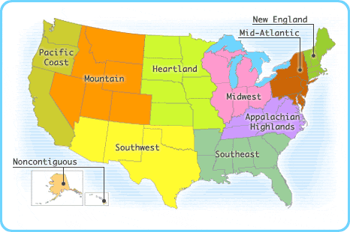
Regions of the U.S./World
What makes these regions unique?

Slide 20
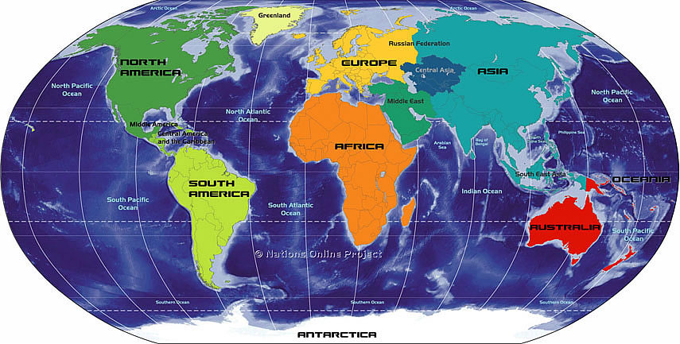
Regions of the U.S./World
What makes these regions unique?

Slide 21
Investigation: The 5 themes of Geography
1. Region: An area with places that share similar characteristics
EX. physical and human features
What region is the place you are researching in?
What are the physical characteristics of your region? List 3
What do you think are the cultural characteristics of your region?

Slide 22
The 5 themes of Geography
What are the physical characteristics of your region? List 5
What do you think are the cultural characteristics of your region? THINK: What do the people of this region have in common?List 5

Slide 23
Exit Ticket
Region paragraph – fill in the blanks

Slide 24
September 16, 2016 Do Now 1. Take out your notebook 2. Open to: The 5 Themes of Geography 3. Answer the following question: Why is important to know “where you are”? DO NOW

Slide 25
Today’s Agenda
Progress Reports
Do Now
Location
I define and explain in writing the aspect of each of the 5 Themes of Geography using academic vocabulary.

Slide 26
Do Now Discussion
Why is important to know “where you are”?

Slide 27
The 5 Themes of Geography
Location: Where places/things are
2 types:
Absolute location: Exactly where something is (latitude and longitude or an address)
Relative Location: Distance and direction to other places
What is our absolute location right now?
39.7392° N, 104.9842° W: Denver, Coordinates
What is our relative location right now?
Which type of location do you think people use more? Why?

Slide 28
The 5 Themes of Geography
Academic Vocabulary
Spatial Relationship: specifies how one place is located in space in relation to some reference object, and how they are connected

Slide 29
The 5 Themes of Geography
Partner Research:
Using your Investigation guide, complete the information about the location of the place you are researching
HINT: For Relative Location – use directionality (north of, south of, east of, west of…)

Slide 30
The 5 Themes of Geography
Writing the paragraph, (use the Region paragraph as a guide)
Intro: Name and define the theme
Body:
Define and state the Absolute Location
Define and state the Relative Location
Conclusion: Transition: Restate and redefine the theme, state the theme coming up
You must use spatial relationship in the paragraph
Workshop or on your own

Slide 31
The 5 Themes of Geography
Exit Ticket:
Completed Location Paragraph

Slide 32
September 20, 2016 Do Now 1. Take out your notebook 2. Open to: The 5 Themes of Geography 3. Answer the following question: What makes Denver a unique place? DO NOW

Slide 33
Today’s Agenda
Progress Reports
Do Now Discussion
Place
I define and explain in writing the aspect of Place as one of the 5 Themes of Geography using academic vocabulary.

Slide 34
Do Now Discussion
What makes Denver a unique place?

Slide 35
The 5 themes of Geography
3. Place: Characteristics of places and the people who live there
2 types
Physical (or natural) characteristics
Human (or cultural) characteristics
What physical characteristics are around us?
What human characteristics are around us?
How are Region and Place connected?

Slide 36
The 5 Themes of Geography
Partner Research:
Using your Investigation guide, complete the information about the location of the place you are researching
Typing up paragraphs:
One person type up Location paragraph

Slide 37
The 5 Themes of Geography
Writing the paragraph, (use the Region paragraph as a guide)
Intro: Name and define the theme
Body:
Outline and name the natural and manmade physical characteristics
Outline and name the human or cultural characteristics
Conclusion: Transition: Restate and redefine the theme, state the theme coming up
Workshop or on your own

Slide 38
The 5 Themes of Geography
Exit Ticket:
Completed Place Paragraph

Slide 39
September 21, 2016 Do Now 1. Take out your notebook 2. Open to: The 5 Themes of Geography 3. Answer the following question: Why is it important to understand spatial relationships? DO NOW

Slide 40
Today’s Agenda
Do Now Discussion
Place
I define and explain in writing the aspect of Movement and Human Environment Interaction as one of the 5 Themes of Geography using academic vocabulary.

Slide 41
Do Now Discussion
Why is it important to understand spatial relationships?

Slide 42
The 5 themes of Geography
4. Movement: The movement of materials, people, or ideas among places
4 categories:
Environmental
Goods and Services
People and Animals
Ideas and information
How do you and the things around you move? Create a list in your team for each category

Slide 43
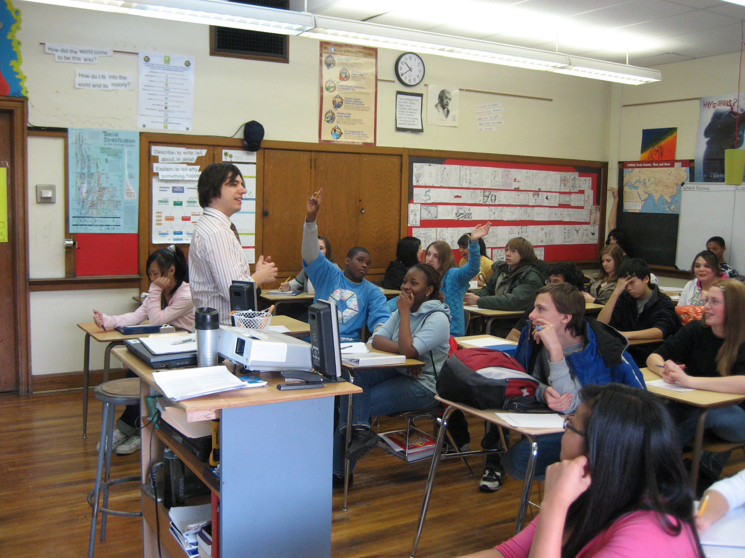
The 5 themes of Geography Which Category of Movement?
Movement: The movement of materials, people, or ideas among places
How do ideas and information move?

Slide 44
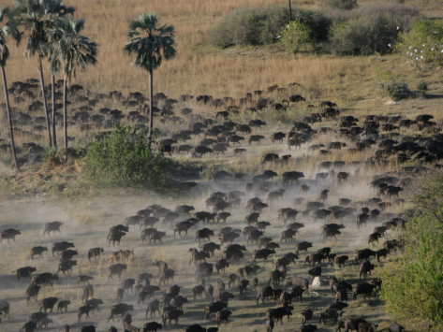
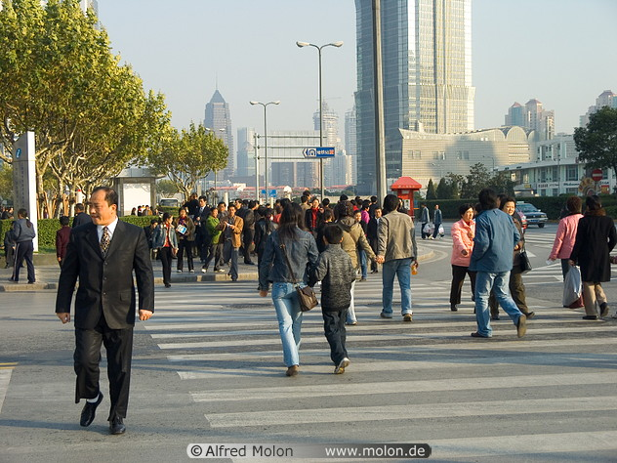
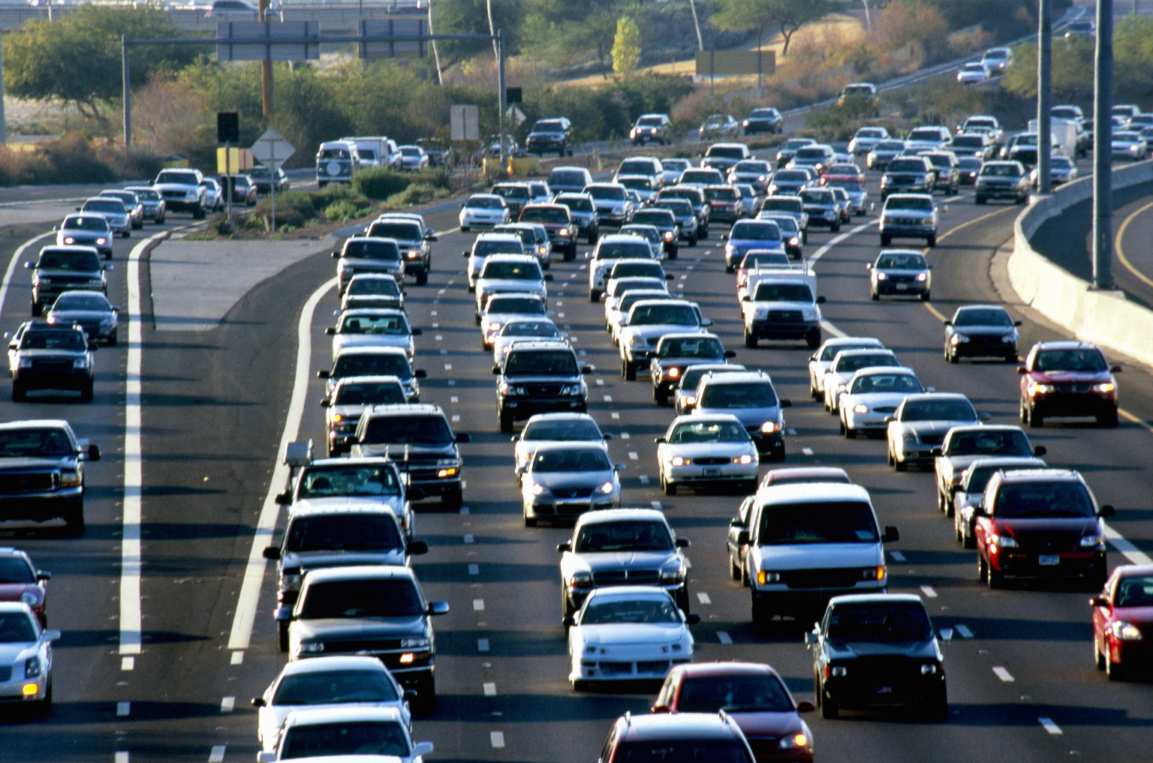
The 5 themes of Geography Which Category of Movement?
Movement: The movement of materials, people, or ideas among places
How do people and animals move?

Slide 45
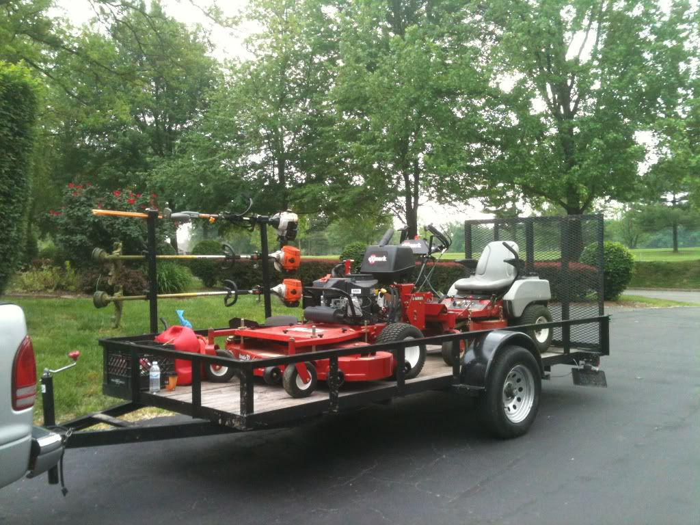
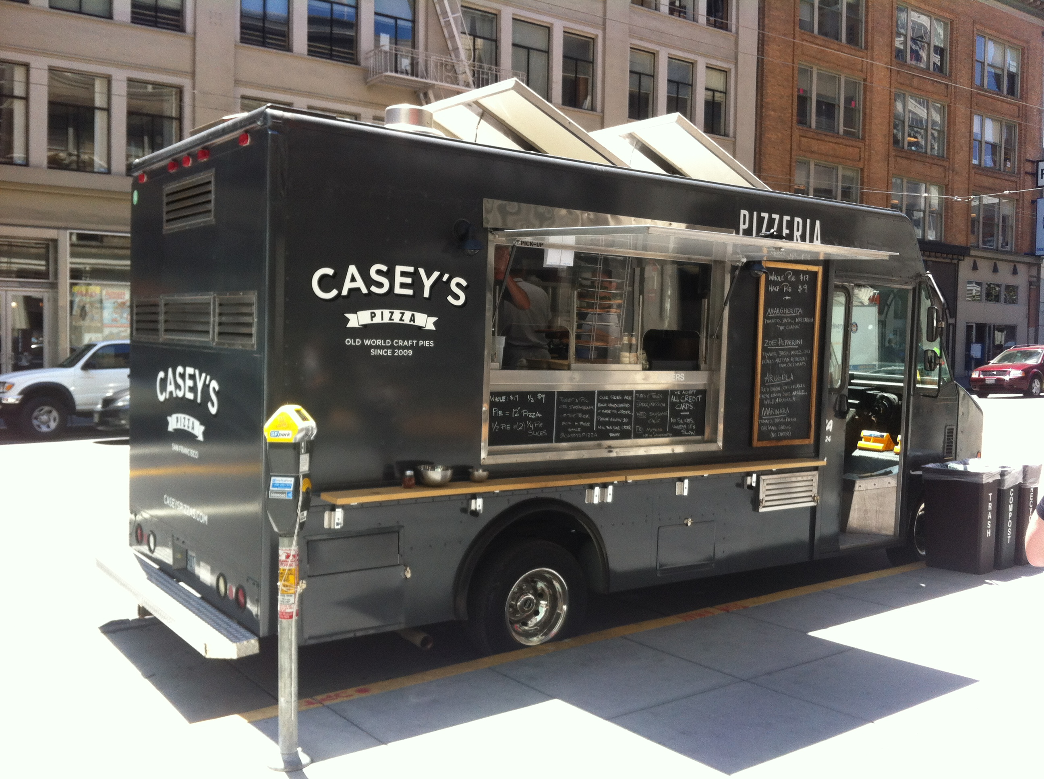
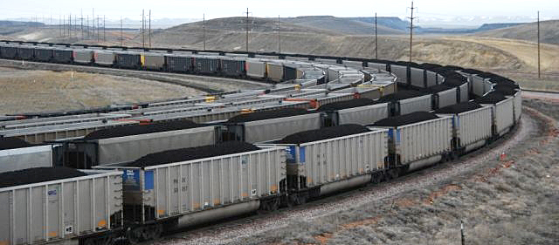
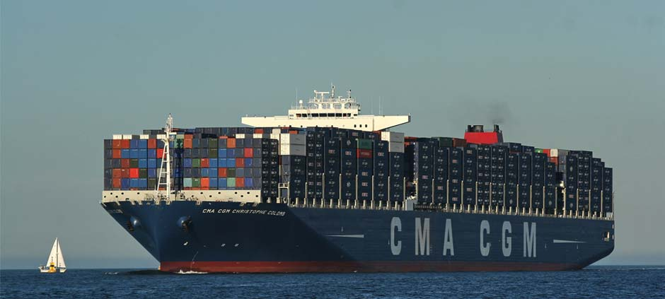
The 5 themes of Geography Which Category of Movement?
Movement: The movement of materials, people, or ideas among places
How do goods and services move?

Slide 46
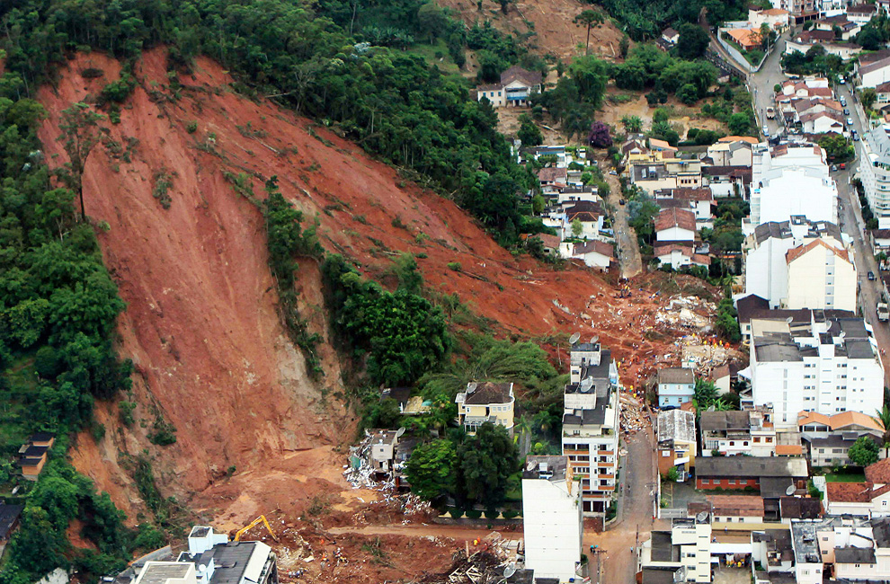
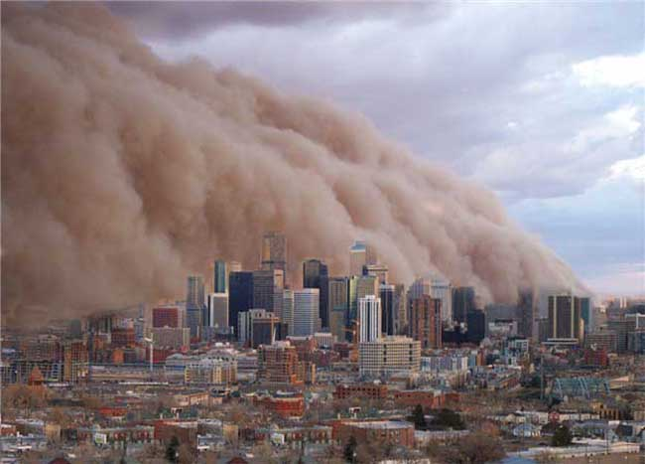
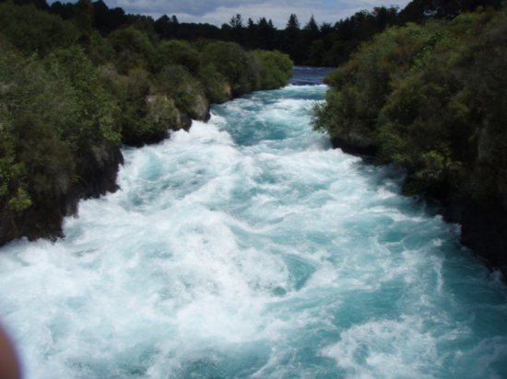
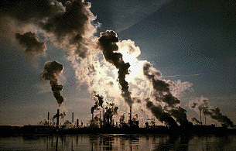
The 5 themes of Geography Which Category of Movement?
Movement: The movement of materials, people, or ideas among places
How does Earth, Air, and Water move?

Slide 47
The 5 Themes of Geography
Partner Research:
Using your Investigation guide, complete the information about the location of the place you are researching
Start with the Vocabulary
Typing up paragraphs:
One person type up Place paragraph

Slide 48
September 27, 2016 Do Now 1. Take out your notebook 2. Open to: The 5 Themes of Geography 3. Answer the following question: Describe the directions for your homework this weekend DO NOW

Slide 49
Today’s Agenda
Do Now Discussion
Movement
I define and explain in writing the aspect of Movement and Human Environment Interaction as one of the 5 Themes of Geography using academic vocabulary.

Slide 50
Do Now Discussion
What are the directions for your homework this weekend?
To notice and think about Movement
Goods
People
Environment
Ideas
Just notice and acknowledge the Movement around you – go as deep as you like

Slide 51
The 5 Themes of Geography
Partner Research:
Using your Investigation guide, complete the information about the location of the place you are researching
Start with the Vocabulary
Typing up paragraphs:
One person type up Place paragraph

Slide 52
The 5 Themes of Geography
Writing the paragraph, (use the Region paragraph as a guide)
Intro: Name and define the theme
Body: Name and describe each type of Movement for the place you are researching
Conclusion: Transition: Restate and redefine the theme, state the theme coming up
You must use Academic Vocabulary
Workshop or on your own

Slide 53
The 5 Themes of Geography
Exit Ticket:
Written Movement Paragraph
Typed Place Paragraph

Slide 54
September 29, 2016 Do Now 1. Take out your notebook 2. Open to: The 5 Themes of Geography 3. Answer the following question: Do you think people have a good relationship with the environment? Why, or why not? DO NOW

Slide 55
Today’s Agenda
Do Now
Human-Environment Interaction
I define and explain in writing the aspect of Human-Environment Interaction as one of the 5 Themes of Geography using academic vocabulary.

Slide 56
Do Now Discussion
Do you think people have a good relationship with the environment? Why, or why not?

Slide 57
The 5 themes of Geography
5. Human Environment Interaction: Relationships between people and their environment
4 Ways humans interact with the environment:
How humans use the resources around them
The impact humans have on the environment
The adaptations people make because of their environment
The natural disasters that exist in the environment

Slide 58
The 5 Themes of Geography
Partner Research:
Using your Investigation guide, complete the information about the location of the place you are researching
Start with the Vocabulary
Typing up paragraphs:
One person type up Movement paragraph

Slide 59
The 5 Themes of Geography
Writing the paragraph, (use the Region paragraph as a guide)
Intro: Name and define the theme
Body: Name and describe each type of Human Environment Interaction for the place you are researching
Conclusion: Sum up the meaning of using the 5 Themes to understand the world
You must use Academic Vocabulary
Workshop or on your own

Slide 60
The 5 Themes of Geography
Exit Ticket:
Completed Human Environment Paragraph

Slide 61
September 30, 2016 Do Now 1. Take out your notebook 2. Take out your Investigation Guide 3. Discuss with your partner: What needs to be done by the end of class to finish the investigation and paragraphs. DO NOW

Slide 62
Today’s Agenda
Do Now
Human-Environment Interaction Research/Paragraph
I define and explain in writing the aspect of Human-Environment Interaction as one of the 5 Themes of Geography using academic vocabulary.

Slide 63
Exit Ticket
Completed Investigation Guide

Slide 64
Exit Ticket - Highlight
What are the two types of location?
How are regions created?
What are the 4 categories of movement?
What characteristics define a place?
What are the 3 ways humans interact with their environments?

