Slide 1
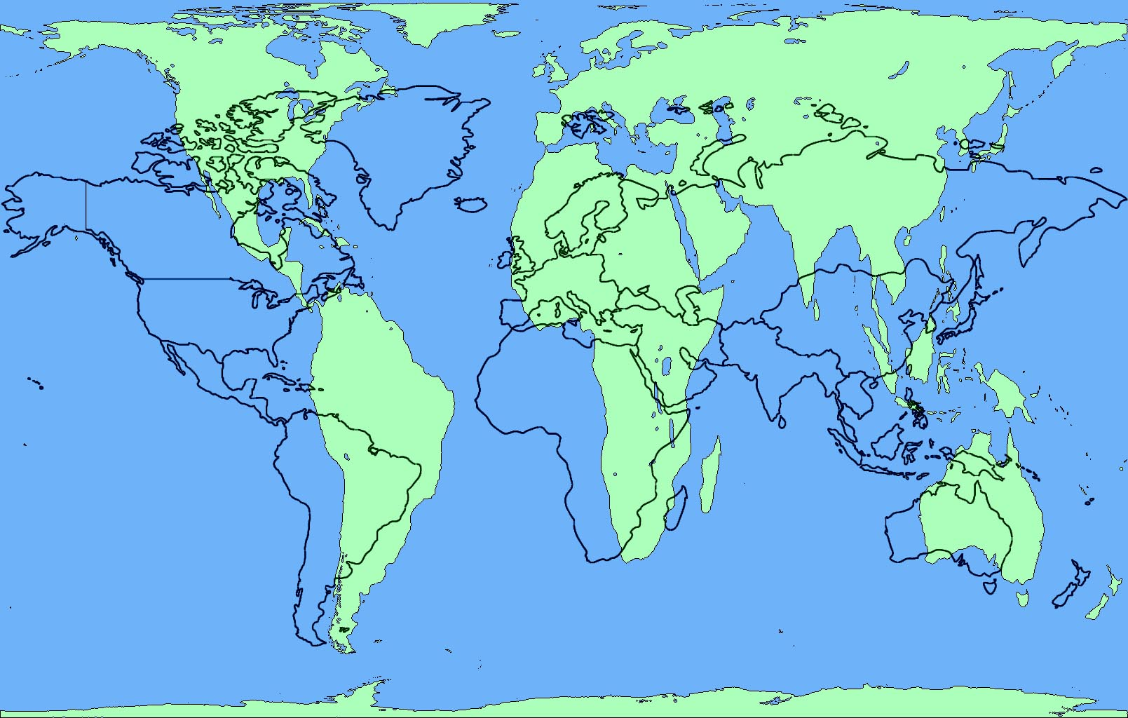
September 6, 2016 Do Now 2. Title your notebook : Unit 1: The 5 Themes of Geography 3. Take out your Principles/Elements of Design paper 3. Answer the following question: What qualities make a design good? DO NOW

Slide 2
Today’s Agenda
I examine the 5 Themes poster and identify and explain explain verbally the positive and negative aspects using academic language from the principles and elements of design.
I define and explain in writing the aspects of each of the 5 Themes of Geography using academic vocabulary.
Introduction: We know who we are, not let’s learn where we are…

Slide 3
Do Now Discussion
What makes a good design layout?
How do you know?
Elements and Principles of Design:
Line
Shape
Texture
Space/Depth
Color
Value
Balance
Unity
Emphasis
Contrast
Pattern
Rhythm
Movement

Slide 4
Unit 1: 5 Themes of Geography
Big Idea: Theme and Organization
Essential Questions:
How/why do Geographers organize the world thematically?
How can understanding each theme of Geography help me better understand the world, other people, and myself?

Slide 5
Unit 1: 5 Themes of Geography
Purposes: Or, why we are doing this
To understand how the the world is organized geographically
To understand how people relate to each other and their environments
To understand how I relate to the other people and the world

Slide 6
5 Themes of Geography Poster Critique
Final Assessments:
Redesigned 5 Themes Poster
5 written paragraphs about each theme based on research
Written evaluation and reflection

Slide 7
5 Themes of Geography Poster Critique
What principles and elements of design are used well? Why?
What principles and elements of design could be improved? Why? How?
What else could be improved? How could it have more “Duende”?

Slide 8
5 Themes of Geography Poster Critique
What principles and elements of design are used well? Why?
What principles and elements of design could be improved? Why? How?
Write 3 improvements that can be made in your notebook
How would you rate the craftsmanship?
How could it have more “duende”?

Slide 9
5 Themes of Geography Poster Project
You will be redesigning the 5 Themes Poster to make it more visually interesting and informative
Last year’s work: How could it be improved?
You will define each theme
Explain each theme based on a location of your choosing
Provide pictures that enhance your definitions and explanation.

Slide 10
Final Project
Redesign the 5 themes poster using images and information based on a place you and your partner select
Your redesign must have all the same headings and elements, but have images and additional definitions, explanations, and information
You can create the poster digitally or physically

Slide 11
Exit Ticket
Select your partner
Write your names on the rubric
Select the place you both will research
Write in project name
On the back of the Art Rubric: What 3 Elements and Principles of Design should be used to focus upon for the poster redesign? Why those?

Slide 12
September 8, 2016 Do Now 1. Take out your notebook 2. Open to: The 5 Themes of Geography 3. Answer the following question: Why is researching/investigation an important part of the design process? DO NOW

Slide 13
Today’s Agenda
I define and explain in writing the aspect of each of the 5 Themes of Geography using academic vocabulary.

Slide 14
The Design Cycle
Investigate/Research
Plan
Create
Reflect (Revise)

Slide 15
Geography Big Ideas/Essential Questions
5 Themes of Geography: The major themes that help us better understand the world through a geographic lens
How do Geographers categorize the world? Why that way?
Culture – The sum of all the parts that make people who they are
How/Why is culture transferred and diffused?

Slide 16
The 5 themes of Geography
1. Region: An area with places that share similar characteristics
EX. physical and human features
What kinds of regions could we make? What characteristics could we base the region on?
What areas of the United States might be regions? Think: What areas in the US have similar land features or similar people?

Slide 17
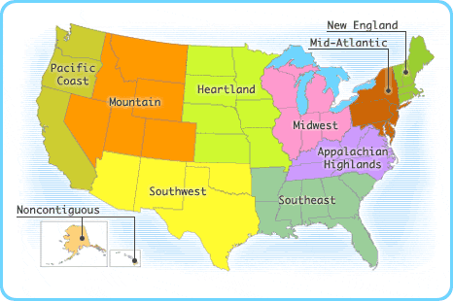
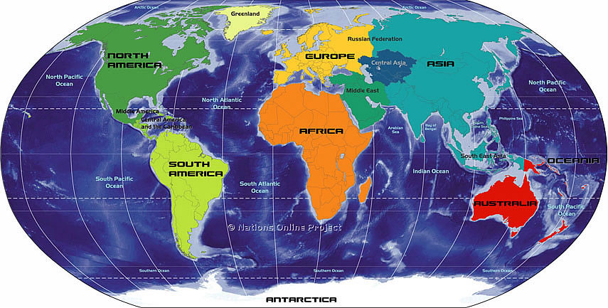
Regions of the U.S./World
What makes these regions unique?

Slide 18
The 5 themes of Geography
1. Region: An area with places that share similar characteristics
EX. physical and human features
What region is the place you are researching in?
What are the physical characteristics of your region? List 3
What do you think are the cultural characteristics of your region?

Slide 19
The 5 themes of Geography
What are the physical characteristics of your region? List 3
What do you think are the cultural characteristics of your region?

Slide 20
Exit Ticket
Region paragraph – fill in the blanks

Slide 21
September 7, 2016 Do Now 1. Title your notebook : Unit 1: The 5 Themes of Geography 2. Take out your Principles/Elements of Design paper 3. Answer the following question: What qualities make a design good? DO NOW

Slide 22
Today’s Agenda
Who You Are Project
Academic Success
I examine the 5 Themes poster and identify and explain explain verbally the positive and negative aspects using academic language from the principles and elements of design.
I define and explain in writing the aspects of each of the 5 Themes of Geography using academic vocabulary.
Introduction: We know who we are, not let’s learn where we are…

Slide 23
Do Now Discussion
What makes a good design layout?
How do you know?
Elements and Principles of Design:
Line
Shape
Texture
Space/Depth
Color
Value
Balance
Unity
Emphasis
Contrast
Pattern
Rhythm
Movement

Slide 24
Unit 1: 5 Themes of Geography
Big Idea: Theme and Organization
Essential Questions:
How/why do Geographers organize the world thematically?
How can understanding each theme of Geography help me better understand the world, other people, and myself?

Slide 25
Unit 1: 5 Themes of Geography
Purposes: Or, why we are doing this
To understand how the the world is organized geographically
To understand how people relate to each other and their environments
To understand how I relate to the other people and the world

Slide 26
5 Themes of Geography Poster Critique
Final Assessments:
Redesigned 5 Themes Poster
5 written paragraphs about each theme based on research
Written evaluation and reflection

Slide 27
5 Themes of Geography Poster Critique
What principles and elements of design are used well? Why?
What principles and elements of design could be improved? Why? How?
Write 3 things that are done well and why they are done well
Write 1 improvement that can be made in your notebook, and why

Slide 28
5 Themes of Geography Poster Critique
How would you rate the craftsmanship?
How could it have more “duende”?
Write 1 thing done well with regard to craftsmanship or duende, and state why it is done well.
Write 2 improvements that can be made with regard to craftsmanship or duende in your notebook, and why.

Slide 29
5 Themes of Geography Poster Critique
How did the makers improve on the poster?
Compare and Contrast
What did they change with regard to principles/elements of design, duende, and craftsmanship?
Write 3 improvements they made, and whether you think they were successful

Slide 30
5 Themes of Geography Poster Project
You will be redesigning the 5 Themes Poster to make it more visually interesting and informative
Last year’s work: How could it be improved?
You will define each theme
Explain each theme based on a location of your choosing
Provide pictures that enhance your definitions and explanation.

Slide 31
Final Project
Redesign the 5 themes poster using images and information based on a place you and your partner select
Your redesign must have all the same headings and elements, but have images and additional definitions, explanations, and information
You can create the poster digitally or physically

Slide 32
Exit Ticket
Select your partner
Write your names on the rubric
Select the place you both will research
Write in project name
On the back of the Art Rubric: What 3 Elements and Principles of Design should be used to focus upon for the poster redesign? Why those?

Slide 33
September 8, 2016 Do Now 1. Take out your notebook 2. Open to: The 5 Themes of Geography 3. Answer the following question: Why is researching/investigation an important part of the design process? DO NOW

Slide 34
Today’s Agenda
I define and explain in writing the aspect of each of the 5 Themes of Geography using academic vocabulary.

Slide 35
The Design Cycle
Investigate/Research
Plan
Create
Reflect (Revise)

Slide 36
Geography Big Ideas/Essential Questions
5 Themes of Geography: The major themes that help us better understand the world through a geographic lens
How do Geographers categorize the world? Why that way?
Culture – The sum of all the parts that make people who they are
How/Why is culture transferred and diffused?

Slide 37
The 5 themes of Geography
1. Region: An area with places that share similar characteristics
EX. physical and human features
What kinds of regions could we make? What characteristics could we base the region on?
What areas of the United States might be regions? Think: What areas in the US have similar land features or similar people?

Slide 38
Regions of the U.S./World
What makes these regions unique?

Slide 39
The 5 themes of Geography
1. Region: An area with places that share similar characteristics
EX. physical and human features
What region is the place you are researching in?
What are the physical characteristics of your region? List 3
What do you think are the cultural characteristics of your region?

Slide 40
The 5 themes of Geography
What are the physical characteristics of your region? List 3
What do you think are the cultural characteristics of your region?

Slide 41
Exit Ticket
Region paragraph – fill in the blanks

Slide 42
The 5 themes of Geography
Location: Where places/things are
2 types:
Absolute location: Exactly where something is (latitude and longitude or an address)
Relative Location: Distance and direction to other places
What is our absolute location right now?
39.7392° N, 104.9842° W: Denver, Coordinates
What is our relative location right now?
Which type of location do you think people use more? Why?

Slide 43
The 5 themes of Geography
3. Movement: The movement of materials, people, or ideas among places
4 categories:
Environmental
Goods and Services
People and Animals
Ideas and information
How do you and the things around you move? Create a list in your team for each category

Slide 44
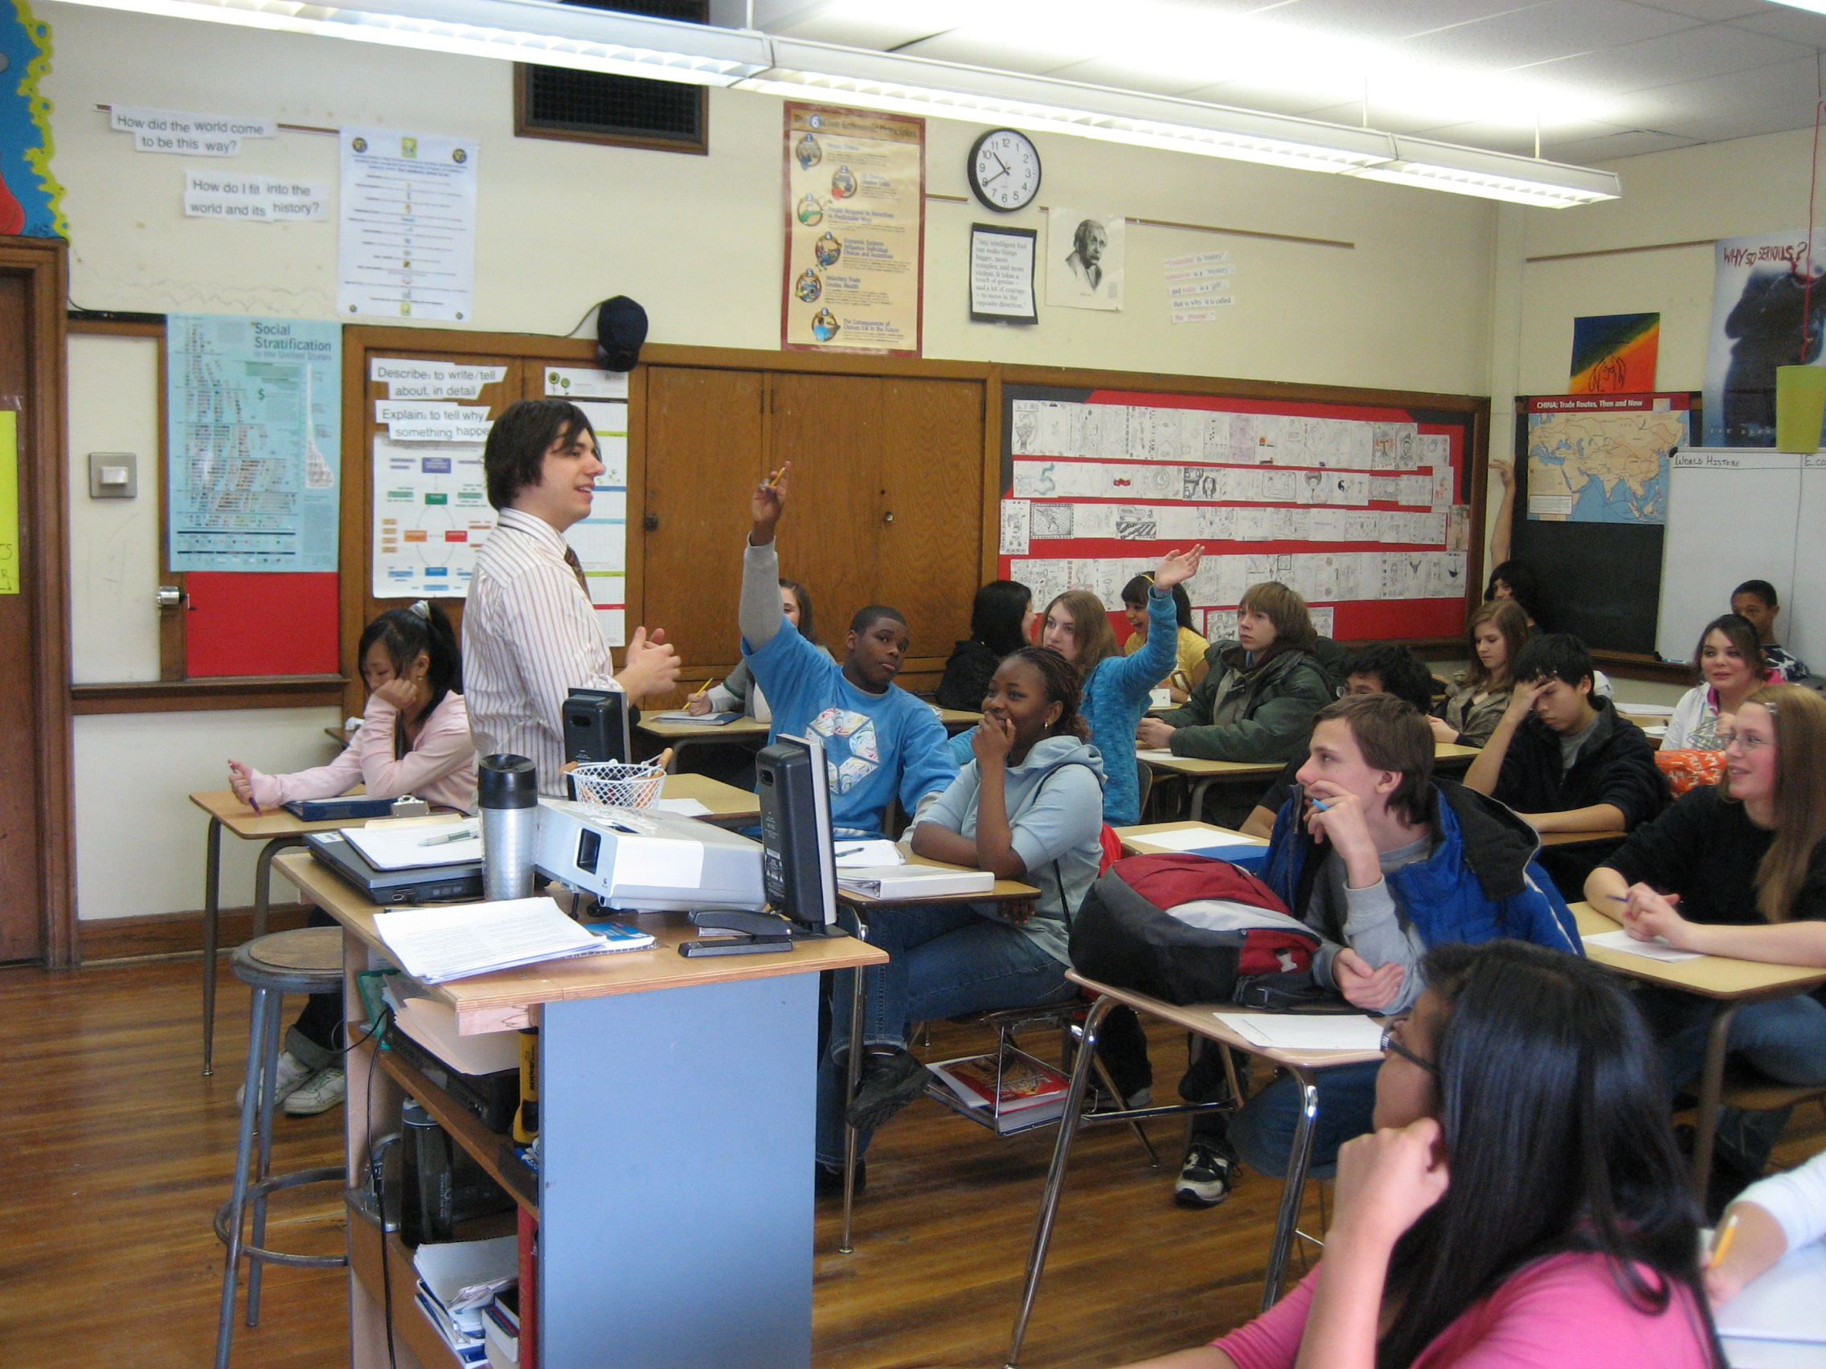
The 5 themes of Geography Which Category of Movement?
Movement: The movement of materials, people, or ideas among places
How do ideas and information move?

Slide 45
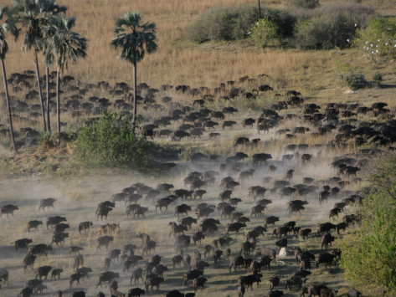
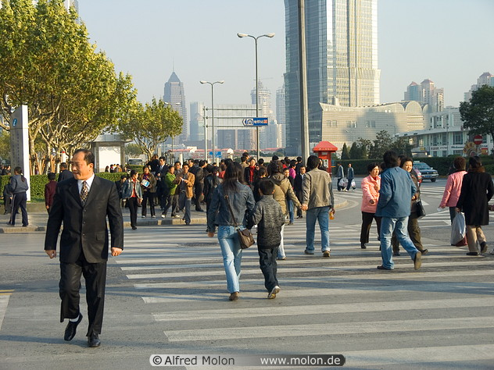
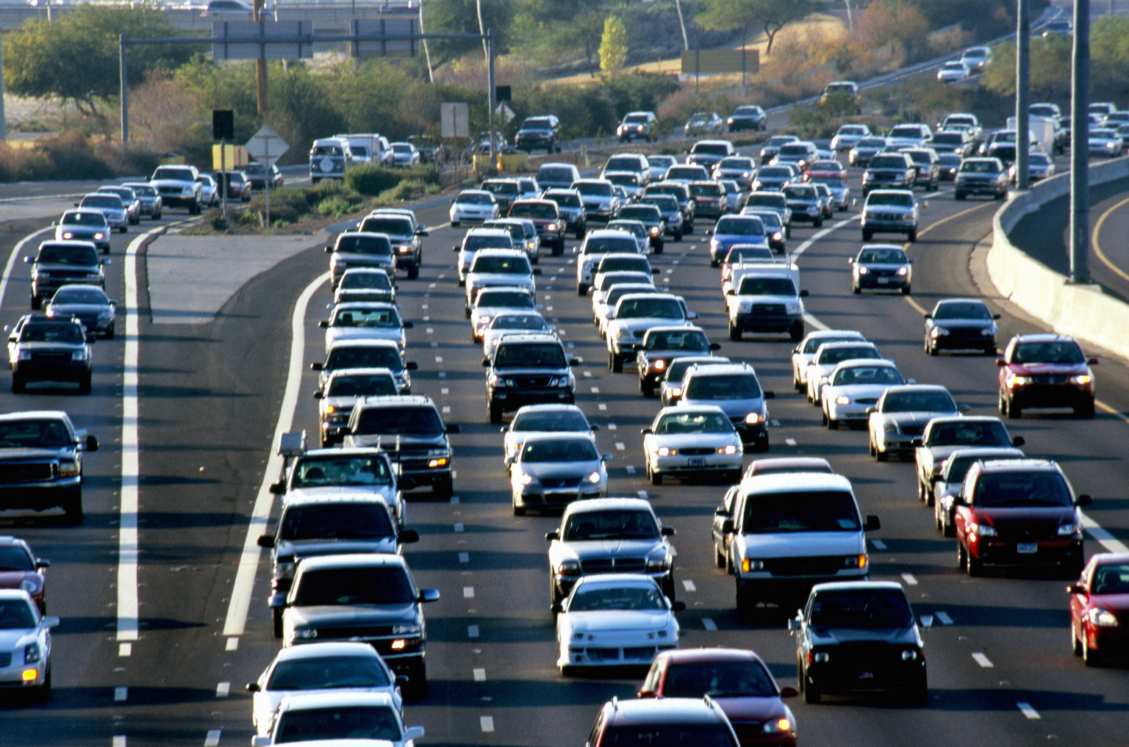
The 5 themes of Geography Which Category of Movement?
Movement: The movement of materials, people, or ideas among places
How do people and animals move?

Slide 46
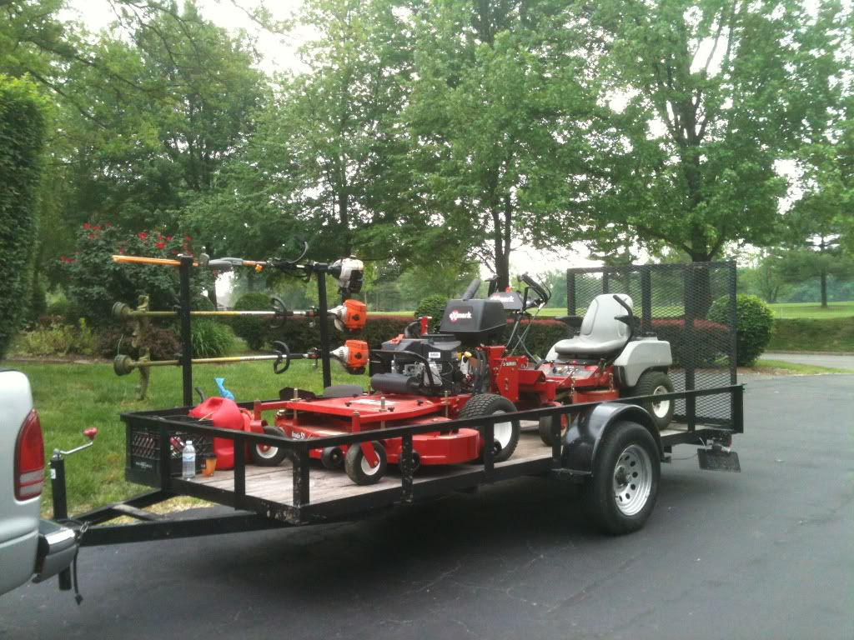
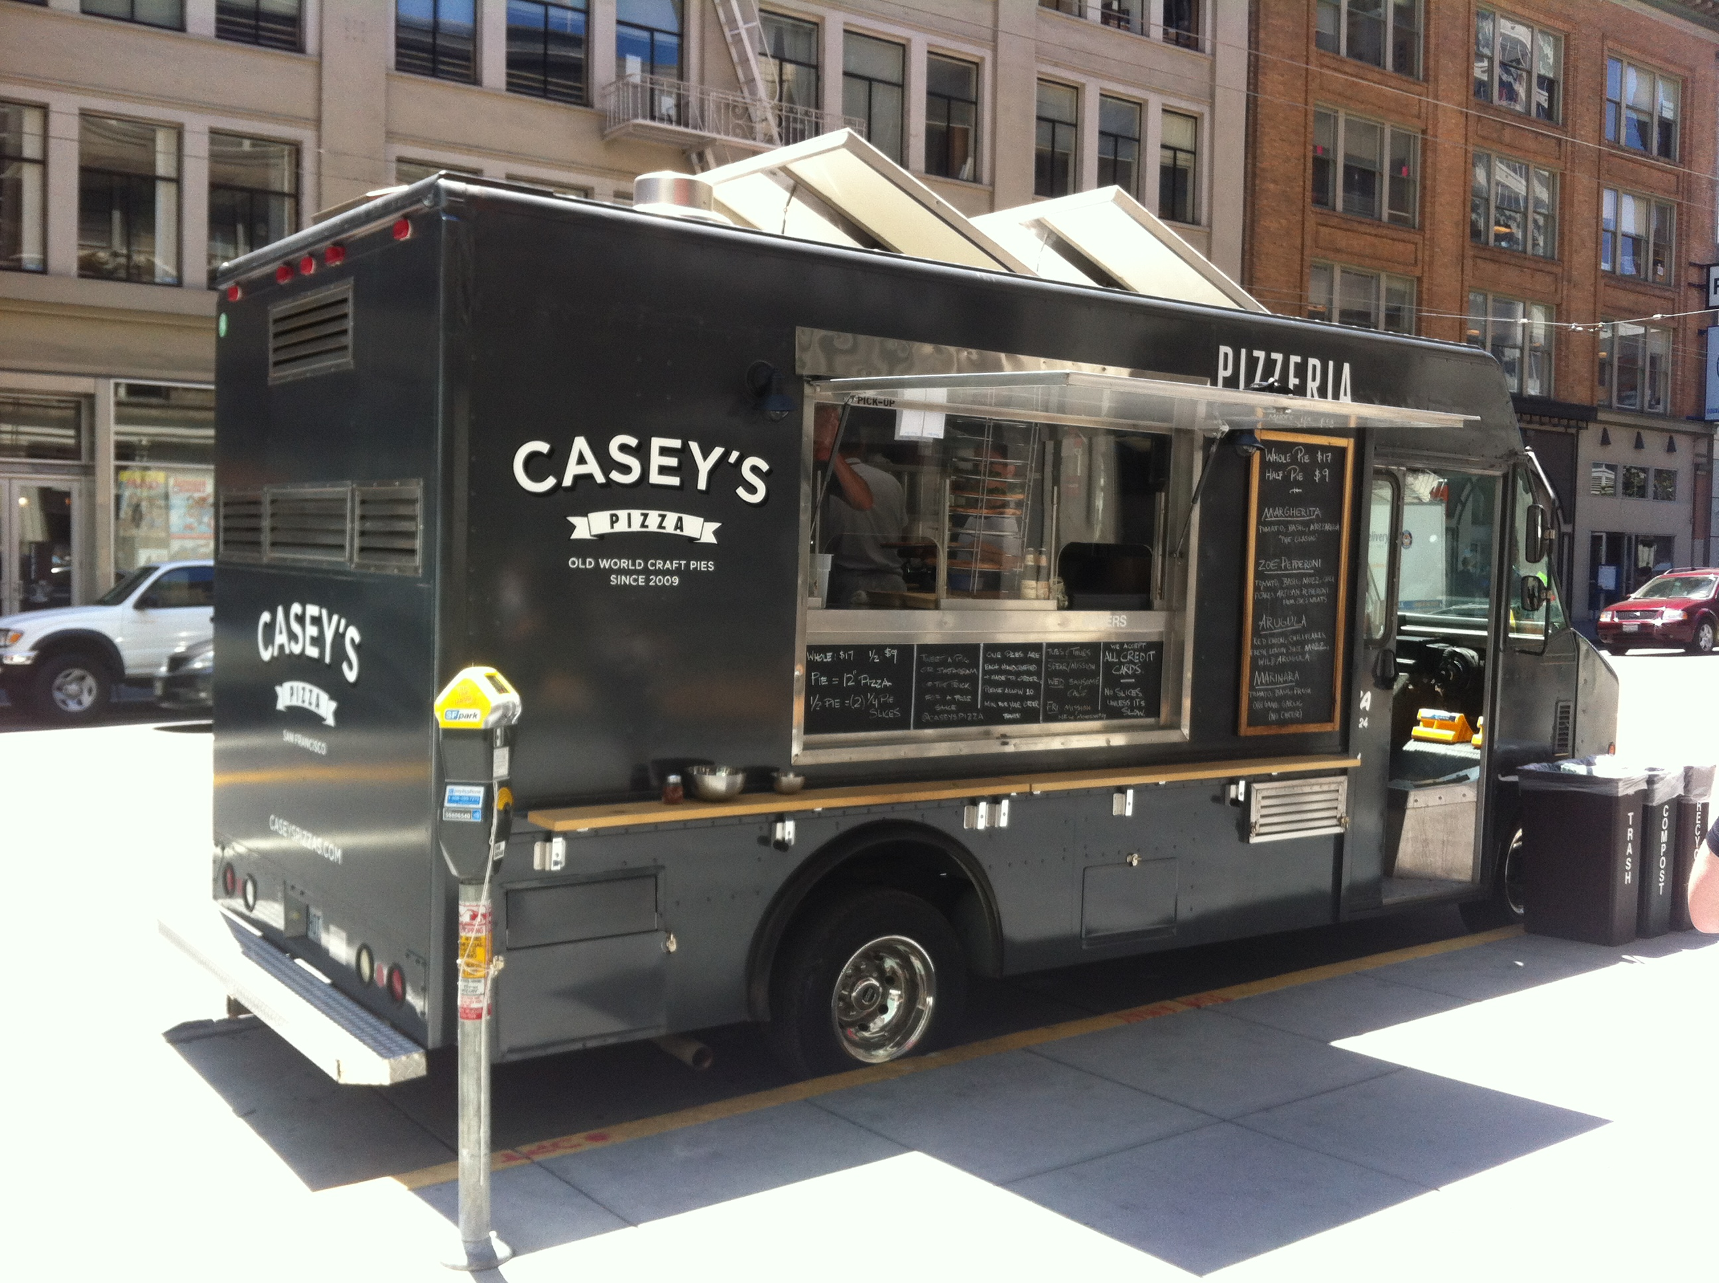
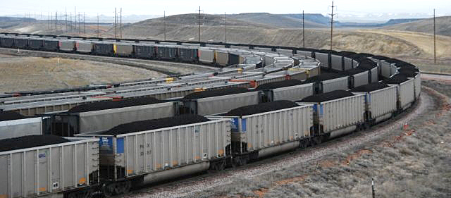
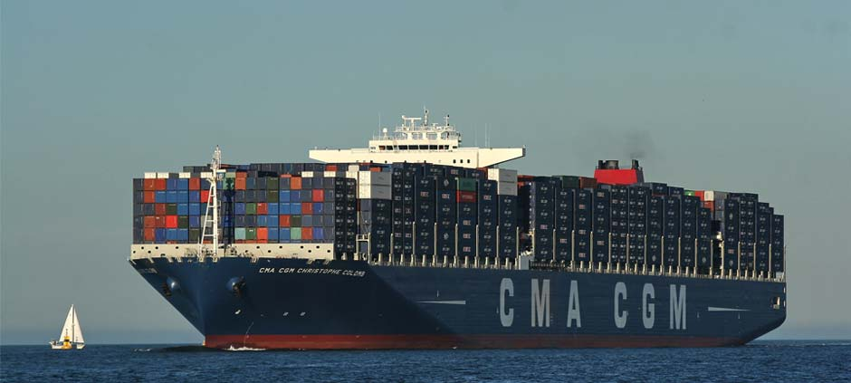
The 5 themes of Geography Which Category of Movement?
Movement: The movement of materials, people, or ideas among places
How do goods and services move?

Slide 47
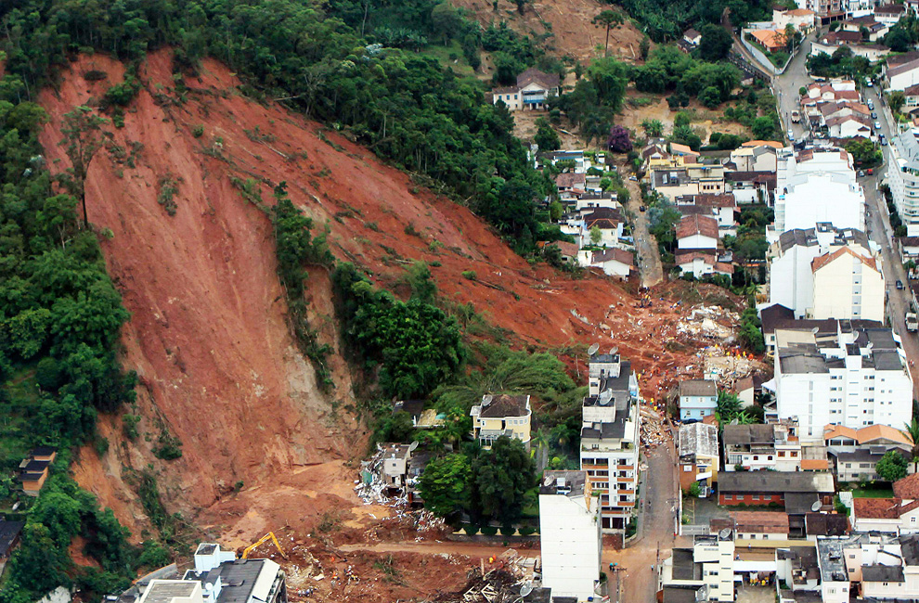
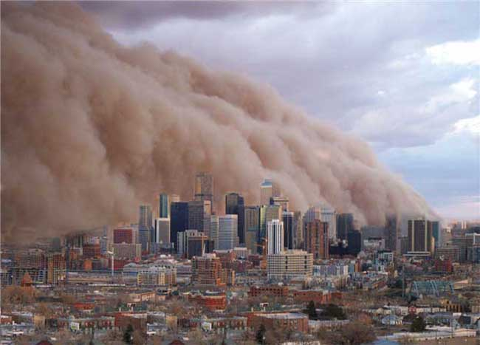
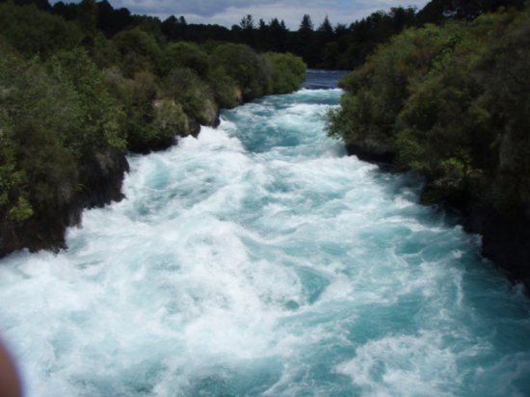
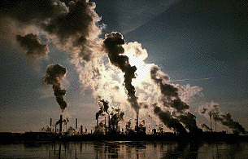
The 5 themes of Geography Which Category of Movement?
Movement: The movement of materials, people, or ideas among places
How does Earth, Air, and Water move?

Slide 48
The 5 themes of Geography
4. Place: Characteristics of places and the people who live there
2 types
Physical (or natural) characteristics
Human (or cultural) characteristics
What physical characteristics are around us?
What human characteristics are around us?
How is region and place connected?

Slide 49
The 5 themes of Geography
5. Human Environment Interaction: Relationships between people and their environment
3 Ways humans interact with the environment:
How humans use the resources around them
The impact humans have on the environment
The adaptations people make because of their environment

Slide 50
Exit Ticket - Highlight
What are the two types of location?
How are regions created?
What are the 4 categories of movement?
What characteristics define a place?
What are the 3 ways humans interact with their environments?

Slide 51
January 13, 2014 Do NOW: In your notebook make 2 lists: 1. 5 places you want to learn more about 2. 5 Human-environment interactions you want to learn more about DO NOW

Slide 52
January 14, 2014 Do NOW: Begin researching for your poster redesign By the end of today, you must have all the research and images completed all 5 of the 5 themes DO NOW

Slide 53
January 16, 2014 Do NOW: Finish your 5 Themes Poster – Be sure to correct all grammar/spelling issues DUE AT THE END OF CLASS DO NOW

Slide 54
Today’s Agenda
I will research and create a poster about the 5 themes of geography
I will be ready for my test on Friday

Slide 55
Final Checklist
Information and Images
All 5 Themes with definitions
Descriptions of the themes with images for the place you researched
Spelling, grammar, and usage corrections (esp. capitalization)
Aesthetics
Color Coding
Arrangement

Slide 56
Researching your Themes
Use maps!!!!!!
Use the guiding questions
Be focused and intentional
Location example
Writing the paragraph
Use your targets!

Slide 57
January 22, 2014 Do NOW: 1. Take out your study guide 2. Look over your study guide for the test DO NOW

Slide 58
Today’s Agenda
I will demonstrate my understanding of the 5 Themes of Geography

Slide 59
Fixing the Poplet
Every box you have text in: hit enter and type a period on the blank line
Email me (mr.abelpype@gmail.com) the pdf

