Slide 1
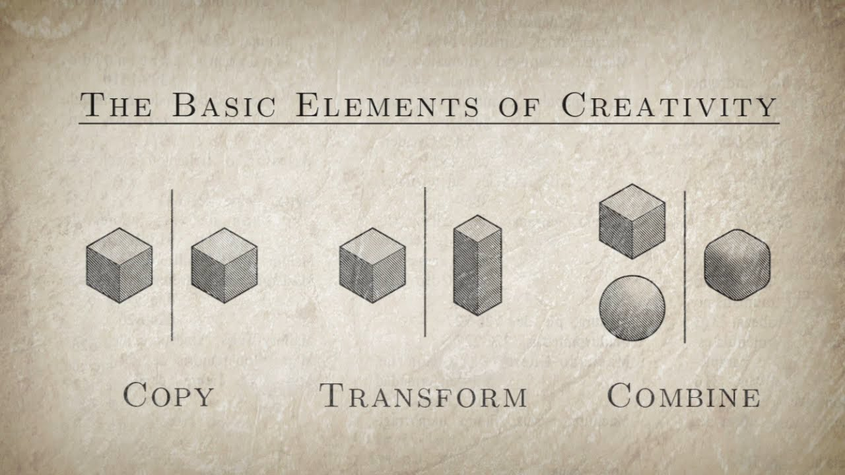
September 1, 2016
Do Now
Turn in homework
Take out your notebook
Title the paper: Everything is a Remix
Answer this question: Is there a such thing as originality? Why, or why not?
DO NOW

Slide 2
Today’s Agenda
I explain verbally the importance of the idea that creativity is copied, transformed, and combined using evidence from a text and academic vocabulary (create, copy, transform, combine, remix).

Slide 3
Do Now Discussion
Is there a such thing as originality? Why, or why not?

Slide 4
Unit 1: Redesigning the Design Cycle
Big Idea: Creativity
Essential Questions:
  How do I use the design cycle to increase my learning and understanding of a topic?
  How/Why is each cycle of the design cycle necessary?
  Why is understanding the design cycle important?
Side Question:
How is the design cycle similar to the writing cycle and the scientific inquiry cycle?

Slide 5
Unit 1: Redesigning the Design Cycle
Final Assessments:
•I create an original art piece using the elements of creativity (copy, transform, combine) to redesign the design cycle graphic.
•I explain using evidence from my art piece and investigation how I copied, transformed, and combined elements to create my redesigned design cycle graphic.
Workplace Skill: Collaboration – Sharing Ideas and Listening

Slide 6
Redesigning the Design Cycle
Investigation
Everything is a Remix
Directions and Purpose
To gain knowledge. For what?
To inform and inspire creativity

Slide 7
Redesigning the Design Cycle
Investigation - Discussion
Part 1: Introduction - Comprehension
With a partner - discuss
What is remixing?
What examples are there?
What is “legal remixing”?

Slide 8
Redesigning the Design Cycle
Investigation - Discussion
Part 1: Introduction - Interpretations
Discuss with a partner
Why does the idea that art is copied, transformed, and combined matter?
THINK: What does it teach us about creating?
5 people discuss together

Slide 9
Redesigning the Design Cycle
Investigation - Discussion
Part 1: Remix Inc. - Comprehension
What are genres?
How are genres still just remixes?
Evidence Star Wars is remixed
What did George Lucas do in order to create Star Wars?
Why does it matter? – What can we learn from what he did?

Slide 10
Redesigning the Design Cycle
Investigation - Discussion
Part 2: Remix Inc. - Interpretations
Discuss with a partner
What can we learn from George Lucas and how he created Star Wars?
Why is the idea that “creation requires influence” meaningful for an artist?
5 people discuss together

Slide 11
Redesigning the Design Cycle
Investigation - Discussion
Exit Ticket:
Viewing guide turned in

Slide 12
Redesigning the Design Cycle
Investigation - Discussion
Part 2: Introduction - Comprehension
Why does the idea that art is copied, transformed, and combined matter?
THINK: What does it teach us about creating?

Slide 13
September 7, 2016
Do Now
Take out your notebook and video guide
Turn to: Everything is a Remix
Answer this question: What did you learn last time about creating?
DO NOW

Slide 14
Today’s Agenda
I explain verbally the importance of the idea that creativity is copied, transformed, and combined using evidence from a text and academic vocabulary (create, copy, transform, combine, remix).

Slide 15
Do Now Discussion
Is there a such thing as originality? Why, or why not?

Slide 16
Unit 1: Redesigning the Design Cycle
Big Idea: Creativity
Essential Questions:
  How do I use the design cycle to increase my learning and understanding of a topic?
  How/Why is each cycle of the design cycle necessary?
  Why is understanding the design cycle important?
Side Question:
How is the design cycle similar to the writing cycle and the scientific inquiry cycle?

Slide 17
Unit 1: Redesigning the Design Cycle
Final Assessments:
•I create an original art piece using the elements of creativity (copy, transform, combine) to redesign the design cycle graphic.
•I explain using evidence from my art piece and investigation how I copied, transformed, and combined elements to create my redesigned design cycle graphic.
Workplace Skill: Collaboration – Sharing Ideas and Listening

Slide 18
Redesigning the Design Cycle
Investigation
Everything is a Remix
Directions and Purpose
To gain knowledge. For what?
To inform and inspire creativity

Slide 19
Redesigning the Design Cycle
Investigation - Discussion
Part 2: Remix Inc. - Interpretations
Discuss with a partner
What can we learn from George Lucas and how he created Star Wars?
Why is the idea that “creation requires influence” meaningful for an artist?
5 people discuss together

Slide 20
Redesigning the Design Cycle
Investigation - Discussion
Part 2: Introduction - Comprehension
Why does the idea that art is copied, transformed, and combined matter?
THINK: What does it teach us about creating?

Slide 21
Redesigning the Design Cycle
Investigation - Discussion
Exit Ticket:
Viewing guide turned in

Slide 22
September 9, 2016
Do Now
Take out your notebook
Title the paper: Redesigning the Design Cycle: Investigation Part 2
Answer this question: Why is important to understand the idea of copy, transform, combine?
DO NOW

Slide 23
Today’s Agenda
I create my own unique design cycle using the creative process of copying, transforming, and combining.
I define in writing the four steps of the design cycle using academic language (Investigate, Plan/Design, Create, Evaluate).

Slide 24
Do Now Discussion
Why is important to understand the idea of copy, transform, combine?

Slide 25
Unit 1: Redesigning the Design Cycle
Big Idea: Creativity
Essential Questions:
  How do I use the design cycle to increase my learning and understanding of a topic?
  How/Why is each cycle of the design cycle necessary?
  Why is understanding the design cycle important?
Side Question:
How is the design cycle similar to the writing cycle and the scientific inquiry cycle?

Slide 26
Unit 1: Redesigning the Design Cycle
Final Assessments:
•I create an original art piece using the elements of creativity (copy, transform, combine) to redesign the design cycle graphic.
•I explain using evidence from my art piece and investigation how I copied, transformed, and combined elements to create my redesigned design cycle graphic.
Workplace Skill: Collaboration – Sharing Ideas and Listening

Slide 27
Redesigning the Design Cycle
Investigation
Investigating: Design Cycle Images and Cycles
Purpose
To gain knowledge. For what?
To inform and inspire creativity. Why?
To give our art meaning. Why?

Slide 28
Redesigning the Design Cycle
Investigation Part 2
The Design Cycle:
Investigate – What does this mean?
Research topics to inform
Plan/Design – What does this mean?
Take knowledge and organize into a creative work
Create – What does this mean?
Use the materials to bring your plan to life
Evaluate – What does this mean?
Critically analyze the work using the principles/elements of design, craftsmanship, and creativity

Slide 29
Redesigning the Design Cycle
Investigation Part 2
The Design Cycle:
First Stage: Planning
Create thumbnail images of the 4 stages

Slide 30
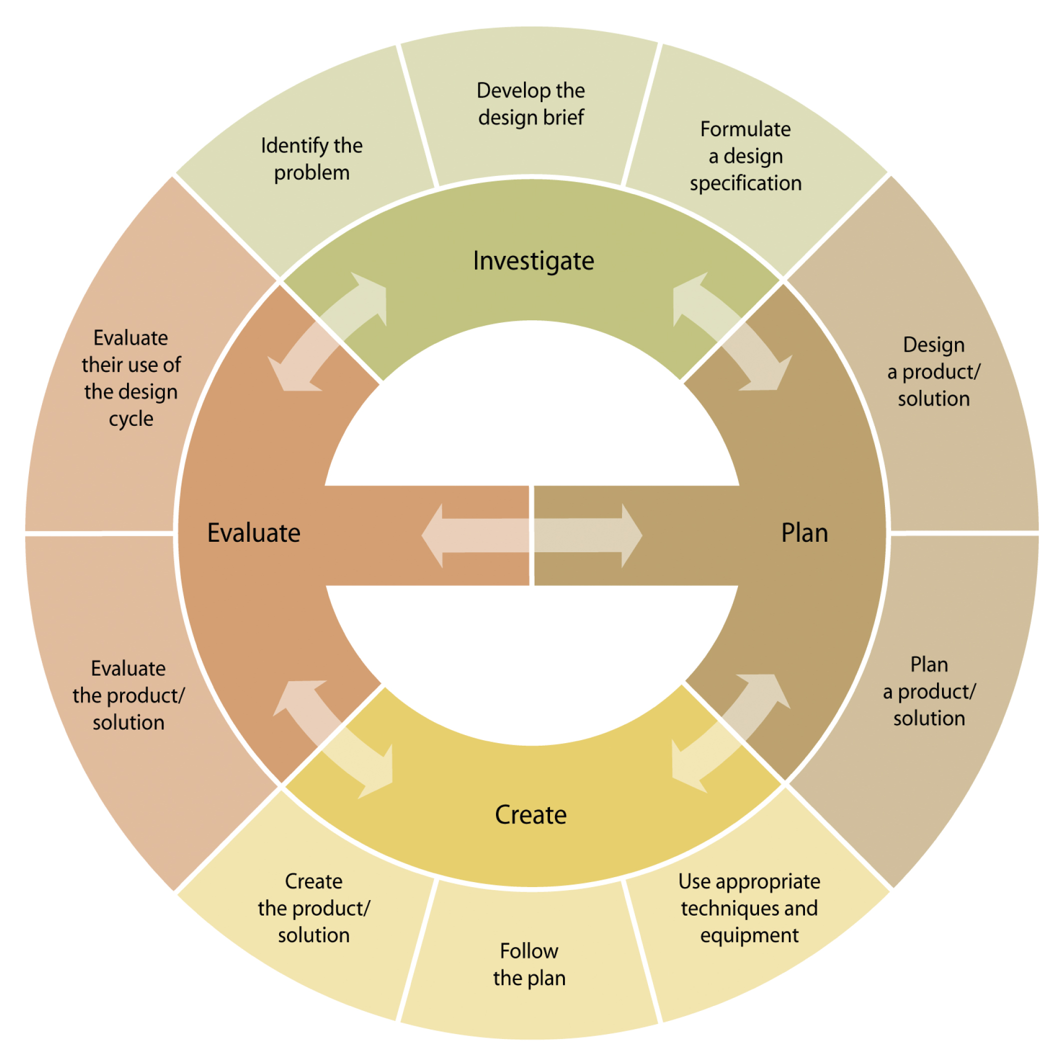
Redesigning the Design Cycle
Investigation Part 2
The Design Cycle:
COPY

Slide 31
Redesigning the Design Cycle
Investigation Part 2
The Design Cycle:
EXAMPLE TRANSFORMATION
How did Mr. Neal Use the creative steps of copying, transforming, and combining?

Slide 32
Redesigning the Design Cycle
Investigation Part 3
What is cycle?
Something that is regularly repeated.
What kinds of cycles are there?
Search (cycle +) EX: science, social, language, art, world, economic, sports….etc...)
List (5)
Copy (3)
This will influence your theme for your redesing

Slide 33
Redesigning the Design Cycle
Investigation Part 3
Exit Ticket:
Challenge Sheet

