Slide 1
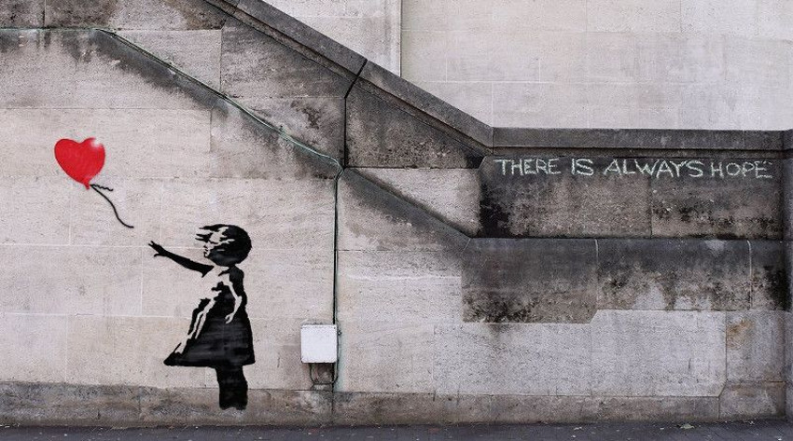
February 13, 2017 DO NOW 1. Take out your notebook and title it: Unit 2: Social Justice 2. Answer this question: What do you think Social Justice means? DO NOW

Slide 2
Today’s Agenda
Do Now Discussion
Unit 2: Essential Questions
Unit 2: Academic Vocabulary
Unit 2: Investigation
I explain in writing what Social Justice is using specific Social Justice issues (various Social Justice issues)

Slide 3
Unit 2: Social Justice
Essential Questions:
How can a creative career work for Social Justice?

Slide 4
Unit 2: Social Justice
Academic Vocabulary:
Social: relating to society or its organization.
Society: people living together in a community.
To what does social refer?
People and their community

Slide 5
Unit 2: Social Justice: Academic Vocabulary
Justice: just behavior or treatment.
Just: based on or behaving according to what is morally right and fair.
Morally: the principles of right and wrong behavior.
What is justice?
Behaving in a way that brings about what is fair and right according to morals
What is injustice?
Behaving in away that brings about unfairness

Slide 6
Unit 2: Social Justice
Academic Vocabulary:
What do we call those that suffer from Social Injustice?
Oppressed
Oppression: prolonged cruel or unjust treatment.
Can we think of any person or group suffering from Social Injustice? How do we know?

Slide 7
Unit 2: Social Justice: Academic Vocabulary
So what is Social Justice?
Acts that raise awareness to and bring about an end to unfairness and oppression for people and groups in society.

Slide 8
Unit 2: Social Justice:
How can a creative career work to end Social Injustices?
Creative Career Exploration:
Graphic Design – Collage or Stencil (Individual)
Performance – perform a monologue/speech/poem (can be original or not) (can be in a group, pair, or individual – needs approval though)
Theatre Design: Create (can be in a pair or individual)
Project must be completed on Friday, March 3rd

Slide 9
Unit 2: Social Justice:
Investigation Phase Part 1: Social Justice Issues
What social justice issues are out there? (Google)
List 10 in your notebook
Circle which three interest you most
Exit Ticket:
Explain at the bottom what social justice is using academic vocabulary (social, justice, morally, oppression, and the 3 issues you circled as examples.

Slide 10
February 15, 2017 DO NOW 1. Take out your notebook and title it: Unit 2: Social Justice 2. Ask a partner: What Social Justice issue do you want to focus on? Why? I will ask your partner what your response was DO NOW

Slide 11
Today’s Agenda
Do Now Discussion
Essential Question and Academic Vocabulary Review
Investigation Part 2: Creative Careers
Investigation Part 3: Art Forms
Investigation Part 4: Researching a Social Justice Issue
I summarize in writing a specific Social Justice issues is using quotes from articles (various quotes from articles relating to the topic)

Slide 12
Do Now Discussion
What Social Justice issue do you want to focus on? Why?

Slide 13
Unit 2: Social Justice
Essential Questions Review:
How can a creative career work for Social Justice?

Slide 14
Unit 2: Social Justice
What is Social Justice?
Acts that raise awareness to and bring about an end to unfairness and oppression for people and groups in society.
What is Social Injustice?
Acts that bring about unfairness and oppression for people and groups in society.

Slide 15
Unit 2: Social Justice:
Investigation Phase Part 2: Creative Careers
Which art form would you like to create?
Graphic Design –Stencil/ Collage (Individual)
Performance – perform a monologue/speech/poem (can be original or not) (can be in a group, pair, or individual – needs approval though)
Theatre Design: Create (can be in a pair or individual)
Why?

Slide 16
Unit 2: Social Justice:
Investigation Phase Part 2: Creative Careers
Discussion
Graphic Design: How can a graphic design artist work for Social Justice? Give Examples
Performance: How can a performance artist work for Social Justice? Give Examples
Theatre Design: How can a set designer work for Social Justice? Give Examples

Slide 17
Unit 2: Social Justice:
Investigation Phase Part 3: Art Forms
Graphic Design: Collage/Stencil
What is a collage?
What is a stencil?
What examples of Social Justice can be found using collages and stencil art?
Which do you want to do? Why?

Slide 18
Unit 2: Social Justice:
Investigation Phase Part 3: Art Forms
Performance: Monologue, Speech, Slam Poem
What is a monologue?
What is a speech?
What is a slam poem
What examples of Social Justice can be found using monologues, speech, slam poem?
Which do you want to do? Why?

Slide 19
Unit 2: Social Justice:
Investigation Phase Part 3: Art Forms
Theatre Design: How can a set designer work for Social Justice? Give Examples
What is involved in designing a set?
What examples of Social Justice can be found using using set design? (movies/plays/musicals)
http://www.slideshare.net/mkyanchak/set-design-101

Slide 20
Unit 2: Social Justice:
Investigation Phase Part 4: Social Justice Issue
Select a social justice issue to focus on for the project
Find 3 articles relating to the issue and summarize
Search pachamama social justice
Select Social Justice Issues
Read the articles and take notes on vocabulary, main ideas/issues, statistics, people’s names, locations, etc…
Exit Ticket (separate sheet of paper turned in): I summarize in writing a specific Social Justice issues is using quotes and data from articles (various quotes and data from articles relating to the topic)

Slide 21
Unit 2: Social Justice:
Planning Phase:
What creative career art form are you creating?
What aspect of that creative career art form are you creating?
What social justice issue are you focusing on?
Using your notes from the articles, sketch out what you would like to create

