Slide 1
Do Now: 1. Get your arm tracing from last class 2. Read through your list and add anything that you may have thought of since the last class (Investigate/Research) 3. Share and discuss your list with a partner DO NOW
August 26, 2016

Slide 2
Today’s Objectives
I will create a representation of myself in an artistic way
I will state in verbally the importance of “duende and craftsmanship”
I will read and summarize verbally the art rubric
I will explain in writing how I used principles and elements of design in my artistic representation
I explain verbally and in writing symbols that represent cultural pieces that represent who I am using complete sentences.

Slide 3
Investigation - Symbolism
What is symbolism?
the use of a symbol or image to represent an idea or thing.
What are examples of symbolism?

Slide 4
Plan and Create
Create symbols for the items in your list
You don’t have to draw them now, you can just write them down
For example: Sister = bird because she has a free spirit
Complete sentence: I chose to use a bird for my sister because she has a free spirit, which has taught me to not worry so much.
Write 3 complete sentences in your notebook.
When you finish, sketch the symbols in your notebook or outside your arm tracing.

Slide 5
Do Now: 1. Get your arm tracing from last class 2. Take out your notebook 3. Title the page: Art Rubric 4. Discuss with a partner why symbolism is important DO NOW
August 29, 2016

Slide 6
Learning Targets
I will create a representation of myself in an artistic way
I will state in verbally the importance of “duende and craftsmanship”
I will read and summarize verbally the art rubric
I will explain in writing how I used principles and elements of design in my artistic representation
I explain verbally how I used principles and elements of design in my artistic representation using language from the art rubric.

Slide 7
Investigation: Do Now Discussion and Review
What is symbolism?
the use of a symbol or image to represent an idea or thing.
Why is the use of symbolism important in art and/or writing?

Slide 8
Investigation
Art Rubric – Read through Meeting and Exceeding Expectations
Craftsmanship – What is it all about? Why is it important?
What is “Duende” all about? Why is it important?

Slide 9
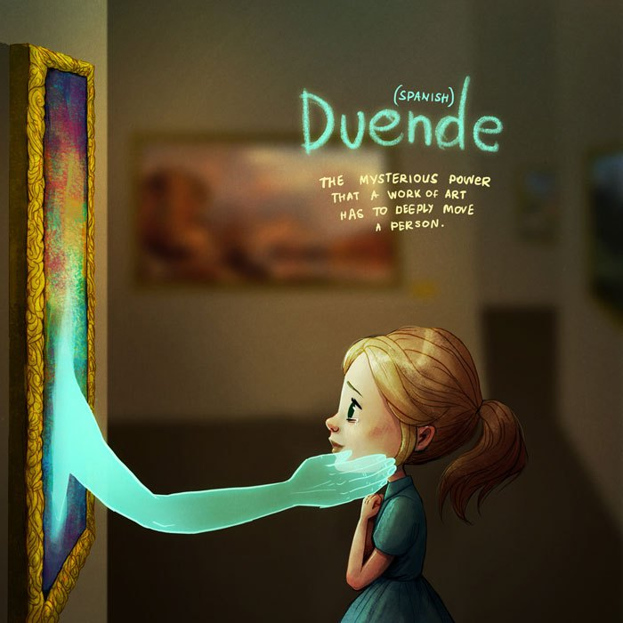
Duende poster

Slide 10
Investigation
Principles and Elements of Design:
Element of Design Focus: Intentional use of Color
Principle of Design Focus: Unity
How do we use color intentionally?
How do we create a unified art piece?

Slide 11
Create
Who You Are Art Piece:
Using your symbols and intentional use of color, create a unified art piece that is a representation of “Who You Are”

Slide 12
Exit Ticket
Who You Are Art Piece:
I explain verbally how I used principles and elements of design in my artistic representation using language from the art rubric.

Slide 13
Do Now: 1. Get your arm tracing from last class 2. Finish creating Who You Are – It is due in about 75 minutes. DO NOW
September 1, 2016

Slide 14
Learning Targets
I evaluate and explain in writing how I used principles and elements of design in my artistic representation using language from the art rubric.
I explain in writing the importance of understanding who I am using academic language.

Slide 15
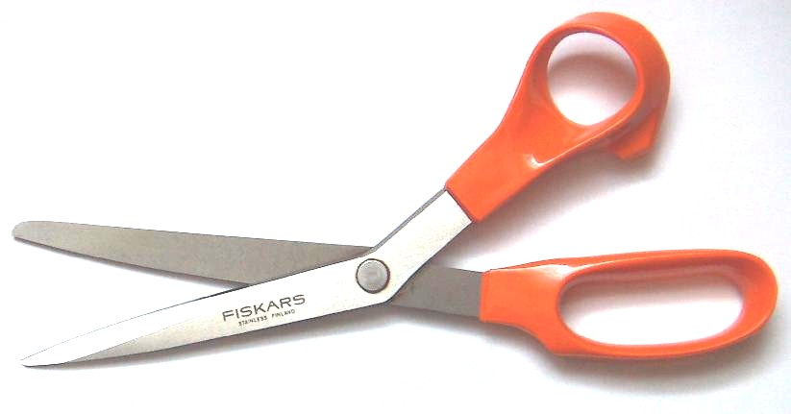
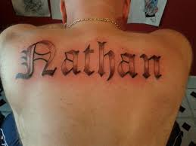
When You Finish…
Cut out your arm
Put your name on the back

Slide 16
Exit Ticket: Evaluation and Reflection
Grade yourself on the art rubric
On the back of the Rubric using properly structured paragraphs:
Explain why it is important to understand “Who You Are.” Be sure use the definition of Who You Are, and what you will do with this knowledge
Explain how you intentionally used color to enhance the “duende” of your art piece – Use specific examples of the art piece as evidence
Explain how you created unity in the art piece by creating a theme/using symbols to represent the most influential pieces of who you are – Use specific examples of the art piece as evidence

Slide 17
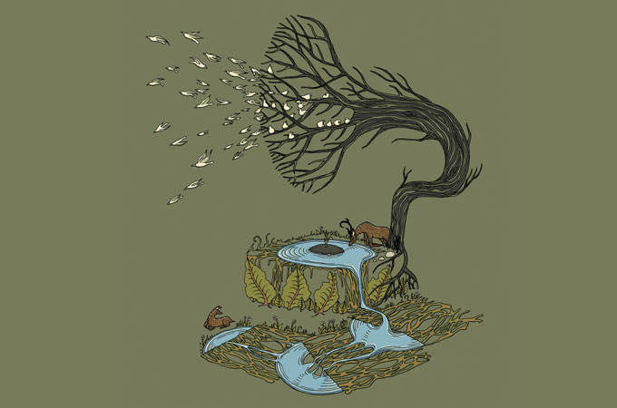
Why are our environments important?
Why are our environments important? What do they do for us?
Why are we important to our environments?
What interesting things are in this environment?

