Slide 1
September 6, 2016 DO NOW: 1. Take out your notebook 2. Title the Page: Sound As A Mechanical Wave 3. Answer this question: If a tree falls in the forest, and no one is around to hear it, does it made a sound? Why do you think so? DO NOW

Slide 2
Today’s Agenda
I will verbally state a position on a philosophical question and support my idea with evidence.
CLO: I explain in writing why sound is a mechanical wave using academic vocabulary (wave, medium, particle to particle interaction).

Slide 3
Do Now Discussion
If a tree falls in the forest, and no one is around to hear it, does it made a sound? Why do you think so?

Slide 4
Content Vocabulary Review
What is frequency?
the rate at which a vibration occurs that constitutes a wave
How it measured?
Hertz (Hz) and Kilohertz (1,000 KHz)
Hertz: The number of cycles per second
What is the distance of a cycle?
From one peak to the next peak of a sound wave
What is reverberation?
When a sound wave bounces of a surface and is reflected back

Slide 5
Experiments…Why is this happening?
Slinky
Tuning Fork
Vacuum Chamber: https://www.youtube.com/watch?v=ViuQKqUQ1U8

Slide 6
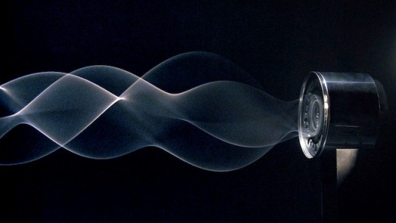
Sound as a Mechanical Wave
What is a Mechanical Wave?
Why is sound a Mechanical Wave?
Why can’t a mechanical wave move through space?

Slide 7
The Physics of Sound
Sound as a mechanical wave
http://www.physicsclassroom.com/class/sound/Lesson-1/Sound-is-a-Mechanical-Wave
Google “physics classroom sound”
Vocabulary:
Sound
Wave
Medium
Mechanical Wave
Frequency
Particle to particle interaction

Slide 8
Exit Ticket
What is a mechanical wave?
A disturbance through a medium that requires particle to particle interaction
Explain how sound a mechanical wave
Sound is a mechanical wave because sound is a disturbance that is transported through a medium via particle-to-particle interaction.
So does the tree make a sound???

Slide 9
September 8, 2016 DO NOW: 1. Take out your notebook 2. Title the Page: Sound Is A Longitudinal Wave 3. Answer this question: When dolphins communicate, how are the sounds (whistles and chirps) able to travel? DO NOW

Slide 10
Today’s Agenda
Progress Reports/Missing assignments
CLO: I explain in writing why sound is a longitudinal wave using content vocabulary and examples from the text.

Slide 11
Review
What is a medium?
What is a mechanical wave?
Why is sound a mechanical wave?
What happens to a sound wave when it hits a solid object? What else? What else?

Slide 12
The Physics of Sound
Sound as a longitudinal wave
Google “physics classroom sound”
Vocabulary:
Longitudinal
Longitudinal Wave
Parallel
Compression
Rarefaction

Slide 13
Sound is a Longitudinal Wave
What is a Longitudinal Wave?
Explain (in your own words) why is sound a Longitudinal Wave. Use an example to support your explanation.

Slide 14
September 13, 2016 DO NOW: 1. Take out your notebook 2. Title the Page: Sound Is A Pressure Wave 3. Answer this question: When dolphins communicate, how are the sounds (whistles and chirps) able to travel? DO NOW

Slide 15
Today’s Agenda
Progress Reports/Missing assignments
CLO: I explain in writing why sound is a pressure wave using content vocabulary and examples from the text.

Slide 16
Review
What is a longitudinal wave?
Why is sound a longitudinal wave?
What is compression?
What is rarefaction?
Why is sound a mechanical wave?

Slide 17
Experiments…
Slinky showing longitudinal waves
Sound in 1 dimension: Wave
Sound in 2 dimensions:
Chilandi Plate: https://www.youtube.com/watch?v=YedgubRZva8
What is happening?

Slide 18
The Physics of Sound
Sound as a pressure wave
Google “physics classroom sound”
Vocabulary:
Pressure Wave
Compression
Rarefaction
Wave length

Slide 19
Sound is a Pressure Wave
What is a Pressure Wave?
Explain (in your own words) why is sound a Pressure Wave. Use two examples to support your explanation.

Slide 20
Experiments…Cymatics
Cymatics: Manipulating matter with sound
Images of sound in liquids: http://www.cymatics.org
https://www.youtube.com/watch?v=Q3oItpVa9fs
Cosmos: https://www.youtube.com/watch?v=f6iXSSewshw
What is happening?

Slide 21
Exit Ticket
What is a pressure wave?
Explain how sound a pressure wave with example

