Slide 1
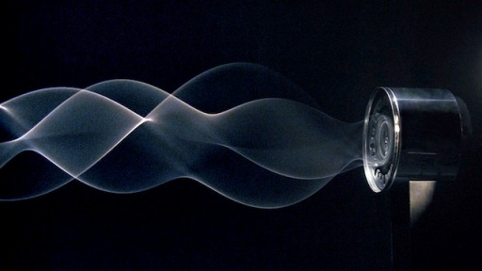
September 1, 2016 DO NOW: 1. Take out your notebook 2. Title the page: The Physics of Sound 3. Answer this question: What do you think sound looks like? DO NOW

Slide 2
Today’s Agenda
Discuss what sound looks like
Draw sources of sounds and their waves
CLO: I will explain orally what I think sound looks like as it moves through the air.
Music Share out

Slide 3
Audio 2
Complete Project Proposal – Directions at the website
Sherlock Holmes – read through/meet with me
Staff Musical

Slide 4
Getting Started…
The purpose for understanding the physics/science of sound
What is Physics?
The branch of science concerned with the nature and properties of matter and energy.
The subject matter of physics includes mechanics, heat, light and other radiation, sound, electricity, magnetism, and the structure of atoms.

Slide 5
Visualizing Sound
What do you think sound looks like?
Let’s take a walk – bring your notebook
Listing the sources

Slide 6
Visualizing Sound
What were the sources of sound outside?
What were the loudest?
How far away were the sources?
From what directions were the sounds coming?
Let’s sketch the sources
Place in the correct directions
Make sources larger for loudness

Slide 7
Exit Ticket
How does sound travel? Why do you think so? Why can I hear it sound but not see it?

Slide 8
September 1, 2016 DO NOW: 1. Open your notebook 2. Create a title page for the first unit: The Physics of Sound part 2 3. Answer this question: What do you learn about when you learn about the physics of sound? DO NOW

Slide 9
Today’s Agenda
Return homework
Discuss an art installation and its relevance to understanding sound waves
Create vocabulary cards for content vocabulary
CLO: I will explain verbally what sound looks like as it moves through the air using academic language (wave, vibration, molecule).

Slide 10
Audio 2
Project Proposals due today – no exceptions

Slide 11
What does the sound wave look like?
Overhead view: https://www.youtube.com/watch?v=dsrUxhaaWks
Draw what sound looks like from an overhead view
What is happening when the waves hit the side of the pool?

Slide 12
What does the sound wave look like?
Side View:
Artist: Daniel Palacios – Art Piece: Waves
2 motors connected by a rope
Created an installation art piece to demonstrate the visualization of sound
http://www.mutantspace.com/daniel-palacios-waves-art-installation/
Draw what sound looks like from a side view

Slide 13
What does the sound wave look like?
What are we seeing?
What forms/shapes are created?
How does this change the way we think about the sound arriving to our ears when we were outside?
Why do you think sound moves in the ways pictured?
What do you think is happening when the wave forms change shape?
What do you think is happening in the air around the source of the vibrations?

Slide 14
Vocabulary Cards/Exit Ticket
Frequency
Cycle
Hertz
Reverberation
Each Card has the word, its definition, a picture to represent the definition, and a complete sentence using the word correctly

Slide 15
The Physics of Sound
Sound as a mechanical wave
http://www.physicsclassroom.com/class/sound/Lesson-1/Sound-is-a-Mechanical-Wave
Google “physics classroom sound”
Vocabulary:
Wave
Medium
Mechanical Wave
Frequency

Slide 16
The Physics of Sound: Exit Ticket
Create Academic Vocabulary Notecards
Your notecard must include:
On the front:
The vocabulary word
On the back:
The definition
A real world example
A visual representation of the vocabulary word

