Slide 1
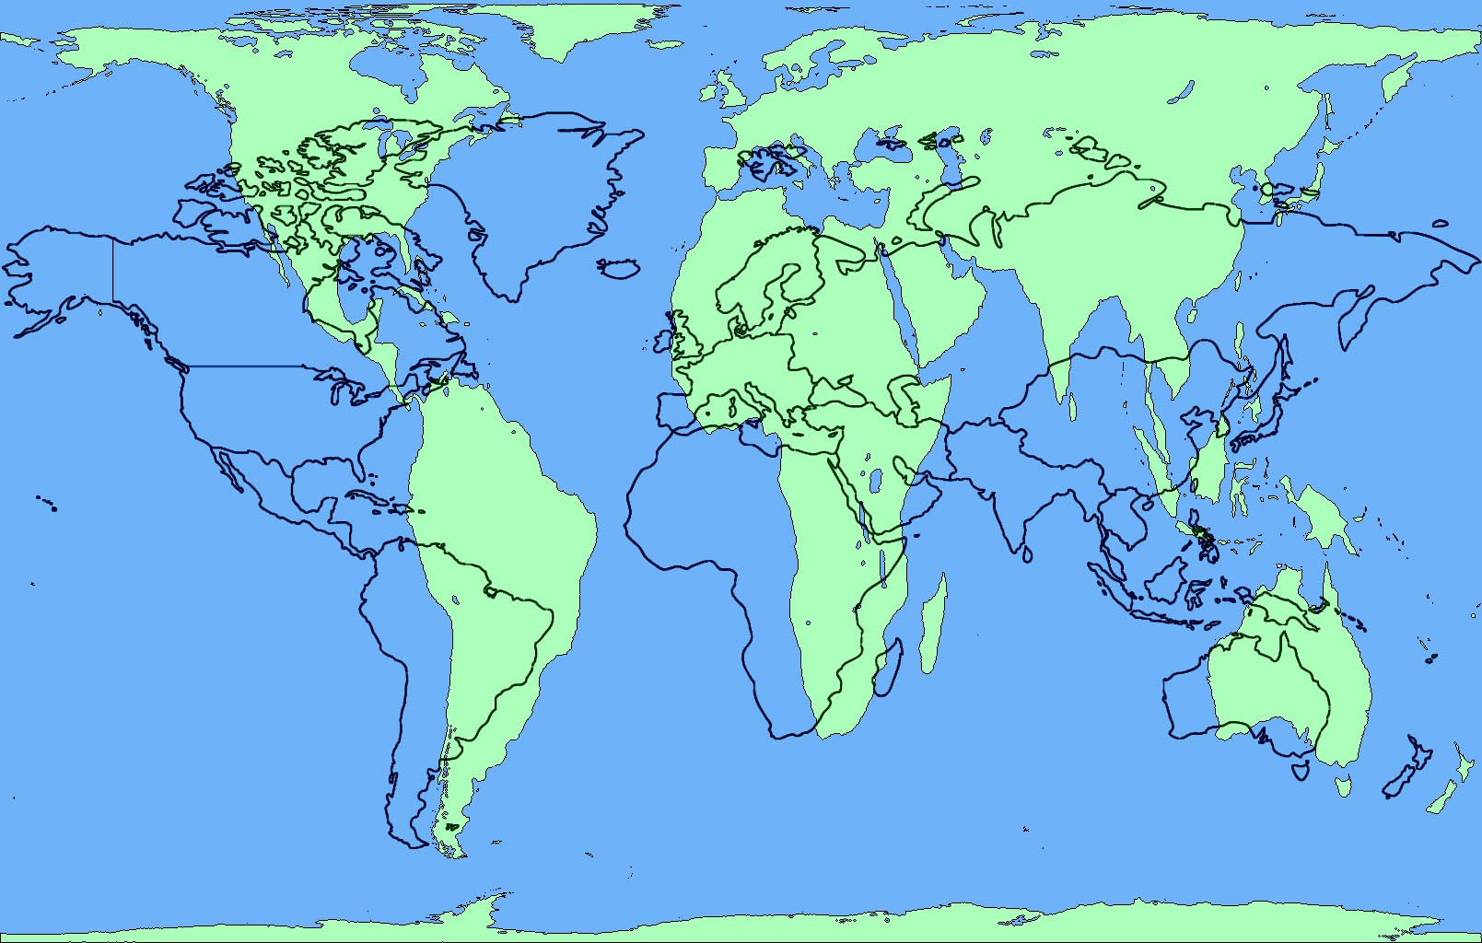
October 3, 2016 Do Now 1. Take out your notebook 2. Title the page: Writing Evaluation 3. Answer this question: When you revise your writing, what do you change? Why?DO NOW

Slide 2
Today’s Agenda
Do Now Discussion
Revising Directions
CLOs:
I deconstruct paragraphs and reassemble them in writing for the purpose of revising and editing using a guide to improve the writing.
I identify and evaluate in writing quality of Geography content regarding each theme of Geography using a writing guide.

Slide 3
Do Now Discussion
When you revise your writing, what do you change? Why?
What stage of the Design Cycle are we in?
Investigate, Plan, Create, or Evaluate
Evaluate for the Writing Section
Revising Guide Direction

Slide 4
Planning Part 1: Evaluating and Revising the Paragraphs
Paragraph Revisions
Varied Sentence Structure: What does it mean to vary the the structure of sentences?
To intentional change the order of parts of the sentence
Why vary sentence structure in writing?
To make the writing more interesting to read
Examples using the Region Intro

Slide 5
Planning Part 1: Evaluating and Revising the Paragraphs
Paragraph Revisions
Transitions: What are transitions in writing?
Words and Phrases that connect and contrast ideas (examples)
Why use transition?
To connect and contrast ideas
To create flow in the writing
To reduce “choppy” sentences
Examples in the Region paragraph

Slide 6
Planning Part 1: Evaluating and Revising the Paragraphs
Revising Guide – Deconstruction
Questions at the end – Review
Complete Location Deconstruction
Type when done – put revised at the top
I identify and evaluate in writing quality of Geography content regarding each theme of Geography using a writing guide.

Slide 7
Exit Ticket
Post Revised Location paragraph in the comments at Kidblog

Slide 8
Do Now Discussion
Why is the planning process an important step to the design cycle?
Imagine and visualize
Generate ideas
Eliminate problems/mistakes
Organize the steps during creation

Slide 9
October 5, 2016 Do Now 1. Take out your Investigation Guide 2. Take out the Paragraph Deconstruction Packet 3. Discuss with your partner: Why are transitions important in my writing? DO NOW

Slide 10
Today’s Agenda
Do Now Discussion
Revising Directions
CLOs:
I deconstruct paragraphs and reassemble them in writing for the purpose of revising and editing using a guide to improve the writing.
I identify and evaluate in writing quality of Geography content regarding each theme of Geography using a writing guide.

Slide 11
Do Now Discussion
Why are transitions important to my writing?
Connect ideas
Contrast ideas
Creates a smooth flow to the writing, and reduces the number of “choppy” sentences

Slide 12
Planning Part 1: Revising and Editing the Paragraphs
Revising Guide – Deconstruction
kidblog.org/class/geography42/posts
Document
Log in: Everyone – Password: KCAArules
Region example
Highlight Transitions
Questions at the end
Download or paper copy? You have to type everything anyway.

Slide 13
Exit Ticket
Post Place and Movement paragraphs in the comments at Kidblog

Slide 14
October 7, 2016 Do Now 1. Take out your Investigation Guide 2. Take out the Paragraph Deconstruction Packet 3. Discuss with your partner: Why is it important to vary my sentence structure for my reader? DO NOW

Slide 15
Today’s Agenda
Do Now Discussion
Revising Directions
CLOs:
I deconstruct paragraphs and reassemble them in writing for the purpose of revising and editing using a guide to improve the writing.
I identify and evaluate in writing quality of Geography content regarding each theme of Geography using a writing guide.

Slide 16
Do Now Discussion
Why is it important to vary my sentence structure for my reader?
Makes the reading more interesting and captivation
It is like adding “duende” to the writing

Slide 17
Planning Part 1: Revising and Editing the Paragraphs
Revising Guide – Deconstruction
kidblog.org/class/geography42/posts
Document
Log in: Everyone – Password: KCAArules
Region example
Highlight Transitions
Questions at the end
Download or paper copy? You have to type everything anyway.

Slide 18
Exit Ticket
Post Human-Environment Interaction paragraph in the comments at Kidblog
kidblog.org/class/geography42/posts
Document
Log in: Everyone – Password: KCAArules

Slide 19
October 10, 2016 Do Now 1. Take out your Planning Phase Guide 2. Look at the 5 Themes Poster on the table 2. Discuss with your partner: What principle or element of design should we focus on for the redesign? Why? DO NOW

Slide 20
Today’s Agenda
I explain in writing the usage of balance, line, and shape in a sketch using complete sentences.
I analyze a sketch for balance, line, and shape, and explain verbally using academic vocabulary what is good, and what could be improved.

Slide 21
Planning Part 2: Sketches
Create your own sketches/Find Images
Which 3 Principles/Elements did you mostly use to guide the creation of this sketch? How are they clearly visible in the sketch?
________ is visible in the sketch by…
I used ___________ because….
I created __________ by ….

Slide 22
Planning Part 3: Brainstorm Meeting
Groups of 4
No one can be in a group with their Design Partner
Share your designs and explain to the members how the Principles and Elements of Design were used, and why you created the layout.
Take notes for each sketch presentation

Slide 23
Planning Part 3: Brainstorm Meeting
After the presentations explain what you liked about the design, and what you might do to improve the design (line, shape, balance)
What I like about the ___(principle/element)____________ is_______________ because ____________.
One thing I might to do to improve the ___(principle/element)____________ is___________________.

Slide 24
Planning Part 4: Summary/Reflection
Discuss with your partner the feedback you received
Complete your final sketch
Exit Ticket
Complete Part 5 for creating your redesign
Begin Creating

Slide 25
Final Sketch
Create a final sketch with your partner

Slide 26
Part 5: Mapping the Create Phase
Create a list of steps you will need to complete in order to create the poster redesign
The steps you list should be headings that contain multiple steps within the step
For example: Revise/Edit Paragraphs using the rubric

Slide 27
Exit Ticket
What is the most important part of the Create Phase of the Design Cycle? Why?
Complete the table for who will complete which parts.
Highlight each step as it is completed
Begin creating
Recommended app: Poplet

Slide 28
Today’s Agenda
I explain verbally in writing the principles and elements of design I used to plan the design of my 5 Themes Poster using academic language.

Slide 29
Partner Discussion
What aspects of the designs worked well? Are there Principles/Elements of Design to focus on? Why?
What aspects of designs didn’t work well? Why? Are there Principles/Elements of Design to avoid? Why?
List what worked well and what didn’t

Slide 30
Final Sketch
Create a final sketch with your partner

Slide 31
Part 5: Mapping the Create Phase
Create a list of steps you will need to complete in order to create the poster redesign
The steps you list should be headings that contain multiple steps within the step
For example: Revise/Edit Paragraphs using the rubric

Slide 32
Exit Ticket
What is the most important part of the Create Phase of the Design Cycle? Why?
Complete the table for who will complete which parts.
Highlight each step as it is completed
Begin creating
Recommended app: Poplet

